Slide 1
Live your life. Create your destiny.
Web 2.0 and Library 2.0
An introduction
TUT Library Workshop
Fatima Darries
9 June 2010
Pretoria, South Africa

Slide 2
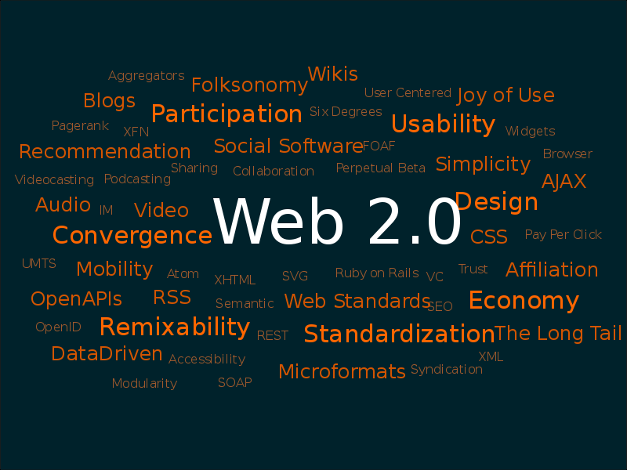
TUT LIS Directorate
Full page photograph or graph
http://en.wikipedia.org/wiki/File:Web_2.0_Map.svg [3 June 2010]
Notes:
Web 2.0 rather than a set definition refers to a set of characteristics where online sharing and collaboration is at its heart, and its made possible by software developers and users of the web.
Web 2.0, is associated with Tim O’Reilly of O’Reilly Media in 2004, refers to a perceived or proposed second generation of web-services – such as social networking sites, wiki’s, communication tools and folksonomies – that emphasize online collaboration and sharing amongst users.

Slide 3
TUT LIS Directorate
Web 2.0 or is it ?
Coined by DiNucci in 1999, http://www.cdinucci.com/Darcy2/articles/Print/Printarticle7.html
“The first glimmerings of Web 2.0 are now beginning to appear … Now we can see that the defining thing about the Web won’t be any visible characteristic at all. The Web will be identified only by its underlying DNA structure—TCP/IP,.. HTTP …, and URLs… As those technologies define its workings, the Web’s outward form—the hardware and software we use to view it — will multiply. “
Popularized by Tim O’Reilly Media Web 2.0 Conference in 2004
Notes:
The term was coined by Darcy DiNucci, in 1999, and is also Web 2.0, is associated with Tim O’Reilly of O’Reilly Media Web 2.0 Conference in 2004, refers to a perceived or proposed second generation of web-services – such as social networking sites, wiki’s, communication tools and folksonomies – that emphasize online collaboration and sharing amongst users.
Fragmented future DiNucci, april 1999. http://www.cdinucci.com/Darcy2/articles/Print/Printarticle7.html
“Web 1.0... The Web as we know it is essentially a prototype—a proof of concept. Now the concept—interactive content universally accessible through a standard interface—has proven so successful that a new industry is now set on transforming it, capitalizing on all the possibilities of that powerful idea.
The first glimmerings of Web 2.0 are now beginning to appear … Now we can see that the defining thing about the Web won’t be any visible characteristic at all. The Web will be identified only by its underlying DNA structure—TCP/IP,.. HTTP …, and URLs… As those technologies define its workings, the Web’s outward form—the hardware and software we use to view it—will multiply. On the front end, the Web will fragment into countless permutations with different looks, behaviors, uses, and hardware hosts. The Web will be understood, not as screenfuls of text and graphics but as a transport mechanism, the ether through which interactivity happens. It will still appear on your computer screen, transformed by the video and other dynamic media made possible by the speedy connection technologies now coming down the pike. It will also appear, in different guises, on your TV set (interactive content woven seamlessly into programming and commercials), your car dashboard (maps, yellow pages, and other traveler info), your cell phone (news, stock quotes, flight info), hand-held game machines (linking players with competitors over the Net), maybe even your microwave oven (automatically finding cooking times for the latest products).

Slide 4
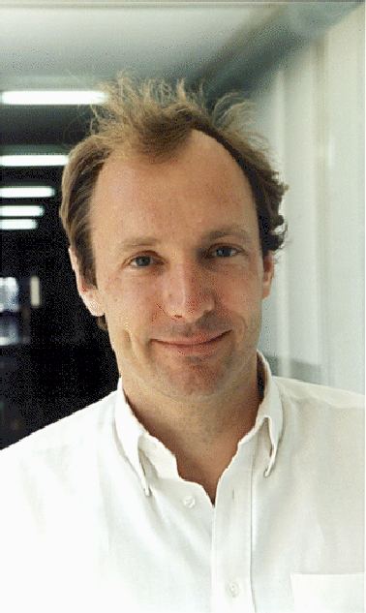
TUT LIS Directorate
Web 2.0 or is it ?
Tim Berners-Lee , developer of www
“Its jargon”
Objectives of Web in 1989
“The provision of a simple protocol for requesting human readable information stored in remote systems accessible using networks; [provision of] a protocol by which information could automatically be exchanged in a format common to the information supplier and the information consumer; to allow documents or collections of documents managed by individuals to be linked by hyperlinks to other documents or collection of documents; the provision of a search option, to allow information to be automatically searched for by keywords, in addition to being navigated to by the following of hyperlinks; [provision of] the necessary software free of charge .”” http://info.cern.ch/Proposal.html
What the web was intended to be
Notes:
The term was coined by Darcy DiNucci, in 1999, and is also Web 2.0, is associated with Tim O’Reilly of O’Reilly Media Web 2.0 Conference in 2004, refers to a perceived or proposed second generation of web-services – such as social networking sites, wiki’s, communication tools and folksonomies – that emphasize online collaboration and sharing amongst users.
Fragmented future DiNucci, april 1999. http://www.cdinucci.com/Darcy2/articles/Print/Printarticle7.html
“Web 1.0... The Web as we know it is essentially a prototype—a proof of concept. Now the concept—interactive content universally accessible through a standard interface—has proven so successful that a new industry is now set on transforming it, capitalizing on all the possibilities of that powerful idea.
The first glimmerings of Web 2.0 are now beginning to appear … Now we can see that the defining thing about the Web won’t be any visible characteristic at all. The Web will be identified only by its underlying DNA structure—TCP/IP,.. HTTP …, and URLs… As those technologies define its workings, the Web’s outward form—the hardware and software we use to view it—will multiply. On the front end, the Web will fragment into countless permutations with different looks, behaviors, uses, and hardware hosts. The Web will be understood, not as screenfuls of text and graphics but as a transport mechanism, the ether through which interactivity happens. It will still appear on your computer screen, transformed by the video and other dynamic media made possible by the speedy connection technologies now coming down the pike. It will also appear, in different guises, on your TV set (interactive content woven seamlessly into programming and commercials), your car dashboard (maps, yellow pages, and other traveler info), your cell phone (news, stock quotes, flight info), hand-held game machines (linking players with competitors over the Net), maybe even your microwave oven (automatically finding cooking times for the latest products).

Slide 5
TUT LIS Directorate
Web 2.0 = 2nd generation web services
Notes:
But there is preceived or proposed 2nd generation web services.
And we have seen the services proliferate.
You will be familiar by now with these logo and you will see more of these through the course of the day.
So today you will be introduced to RSS feeds and readers
RSS- Really Simple Syndication, Rich Site Summary The benefits of RSS are simple: instead of having to visit websites and browse for updated
content, RSS delivers website content directly to you.
http://www.go2web20.net/

Slide 6
TUT LIS Directorate
Web 2.0
Much easier to create content - no longer for specialists – real write web
Much easier for people to collaborate – everything can be shared.
Technology is no longer hardware dependant- Web 2.0 software is stored on Internet –
Adolphus, 2009, Emeraldinsight
Notes:
With Web 2.0 technologies it is much easier to create conteny

Slide 7
TUT LIS Directorate
Library 2.0 Service
“Academic libraries always had elements of the Web 2.0 to them, but without the 2.0 technology. Much the same, the exchange of information in real-time (think phone and F2F reference) is not new to libraries, but we now have the convenience, immediacy and community presence of the real-time web world.”
StevenB on ACRLog, 2009.
Notes:
What does Web 2.0 mean for Library services.

Slide 8
TUT LIS Directorate
Library 2.0 Service
User-generated/user participation library service evolution
Enable more user participation
Reach out to users in the spaces they prefer to be
More user-engaged instruction sessions
“The user is participant, co-creator, builder and consultant whether the product is virtual or physical”
http://en.wikipedia.org/wiki/Library_2.0
Notes:
“With Library 2.0, library services are frequently evaluated and updated to meet the changing needs of library users. - User generated
Library 2.0 also calls for libraries to encourage user participation and feedback in the development and maintaining of library services. The active and empowered library user is a significant component of Library 2.0.”
With information and ideas flowing in both directions – from the library to the user and from the user to the library – library services have the ability to evolve and improve on a constant and rapid basis. The user is participant, co-creator, builder and consultant – whether the product is virtual or physical.” http://en.wikipedia.org/wiki/Library_2.0

Slide 9
TUT LIS Directorate
Library 2.0 is a real-time library
Socially networked, has an active presence and shares information in real time
Updates its status regularly on a daily basis
Offers targeted services to the networked community
Accessible on real-time communication devices
Ready and waiting – all the time- to deliver information services

Slide 10
TUT LIS Directorate
Library 2.0 is a real-time library
Monitors the multitude of emerging real time web services and
Experiments to find those with the potential to enhance service in real time mode
Designs information services specifically for delivery and use on the real-time web
(StevenB on ACRLog, 2009.)

Slide 11
TUT LIS Directorate
Librarian 2.0
Adept at creating relationships with real-time library users
Understands the user’s views and aspirations, and goes where the user goes
Connects people to expert discussion, technology and information, in a suitable context and by the medium of their choice
Delivers services in a device independent manner, on everything from laptops to PDAs and iPods

Slide 12
TUT LIS Directorate
Librarian 2.0
Does not see his /her role as confined to text: collection also contains pictures, videos, DVDs and even games. Both in print and electronic resources are provided seamlessly.
Uses non-traditional cataloguing methods used on user input for content descriptions, classifications and metadata, we well as tagging, tag clouds and folksonomies
Does advanced social networks for the benefit of the business
Understand the principle of the long tail, and the need to reach people who are not usually reached
Notes:
Folksonomies = A folksonomy is a system of classification derived from the practice and method of collaboratively creating and managing tags to annotate and categorize content;^{[1][2]} this practice is also known as collaborative tagging, social classification, social indexing, and social tagging.^{[citation needed]} Folksonomy, a term coined by Thomas Vander Wal, is aportmanteau of folk and taxonomy http://en.wikipedia.org/wiki/Folksonomy
Longtail =

Slide 13
TUT LIS Directorate
Librarian 2.0
Develops the latest search techniques – targeted federated search and open URL, which uses a link resolver to link directly to the resource
Uses open sources such as Open Content Alliance, Google Books Search and Openworldcat
Scrutinizes usage data for insights into user behaviour, and understands the “wisdom of crowds”
Abram, 2007. Online Information 2007 Conference Proceedings. December 4-6. London
Notes:
Open Content Alliance = The Open Content Alliance (OCA) is a consortium of organizations contributing to a permanent, publicly accessible archive of digitized texts. Its creation was announced in October 2005 by Yahoo!, the Internet Archive, the University of California, the University of Toronto and others ^{[1]}. Scanning for the Open Content Alliance is administered by the Internet Archive, which also provides permanent storage and access through its website. http://en.wikipedia.org/wiki/Open_Content_Alliance
User behaviour- millenials, digital natives, and generation theories.
Wisdom of crowds= The Wisdom of Crowds = the theory that a larger group of diverse people can make better decisions, and display more intelligence than any smaller collection of experts
James Surowiecki's book of the same title focuses on collaborations whereby "a diverse group of individuals work largely independently of one another". http://p2pfoundation.net/Wisdom_of_Crowds

Slide 14
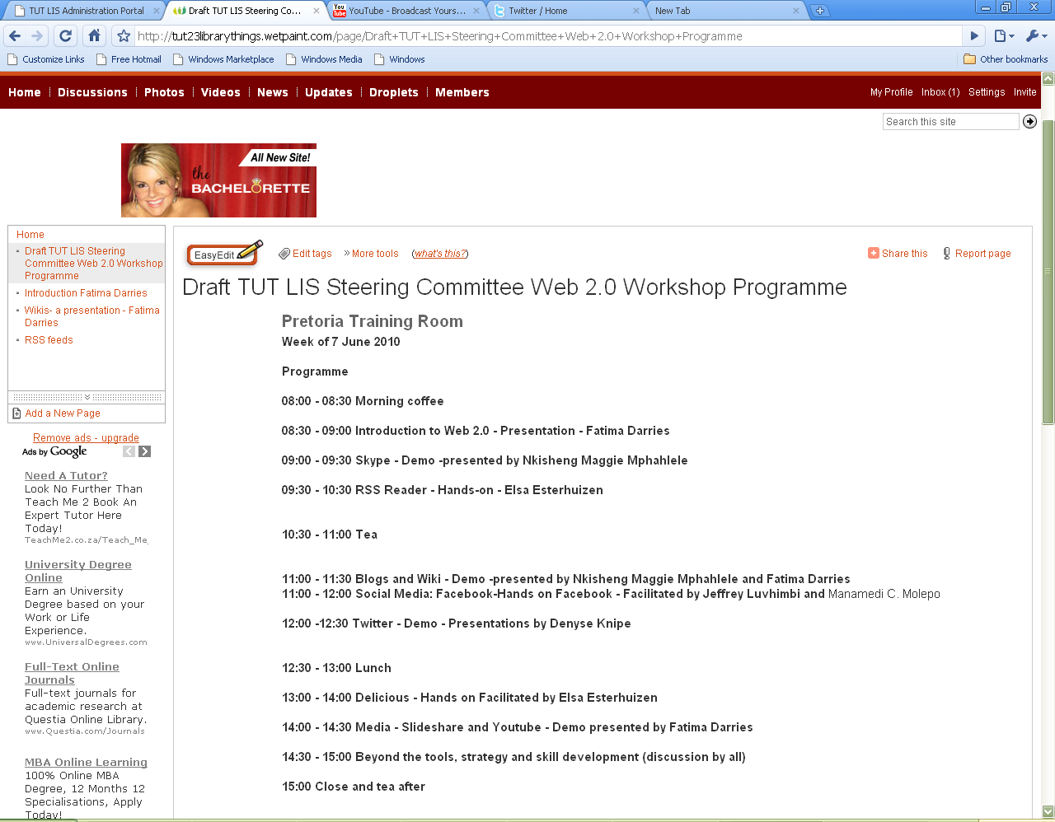
TUT LIS Directorate
http://tut23Librarythings.wetpaint.com
TUT LIS Strategy 2009 - point no 5, Library Model, pg 11-13
Notes:
Why should we bother. Why should TUT bother with 23 Web.2 tools and services?
Because its where our students are
We have also already committed to it in the TUT strategy.

Slide 15
TUT LIS Directorate
Learning 2.0 – 7 ½ habits
Begin with the end in mind
– set goals, re-evaluate
Accept responsibility for your own learning
– you investing in you and your future, celebrate your achievements
3. View problems as challenges
-opportunities and motivation to learn
4. Have confidence in yourself as a competent, effective learner
-crawl before we run, use positive affirmations

Slide 16
TUT LIS Directorate
Learning 2.0 – 7 ½ habits
5. Create you own learning toolbox
-books, websites, mentors, manuals, webinars, online tutorials
6. Use technology to your advantage
-Use it to make your life easier, find and download “how to” online
7. Mentor or coach others
-”Best way to learn is to teach someone else”, reinforces what you know
http://www.slideshare.net/LoriReed/7-12-habits-of-lifelong-learners

Slide 17
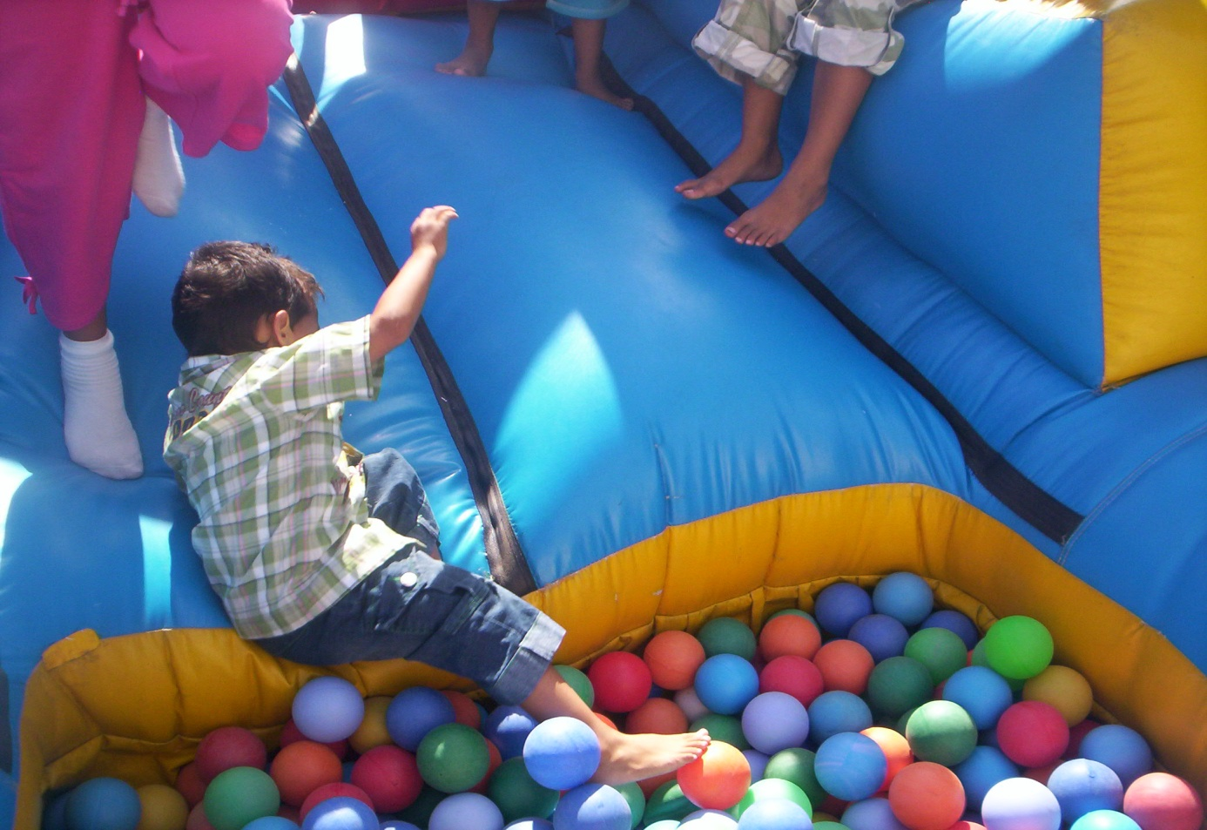
TUT LIS Directorate
Learning 2.0 – 7½ habits
Play!
http://www.slideshare.net/LoriReed/7-12-habits-of-lifelong-learners
Notes:
Playing allows us to be creative. And have fun!

Slide 18
TUT LIS Directorate
Resources
This presentation at http://eprints.rclis.org/18609
This and other resources at http://tut23librarythings.wetpaint.com/page/Introduction+Fatima+Darries
Commons Attribution-Noncommercial-Share Alike 2.5 South Africa License

