Slide 1

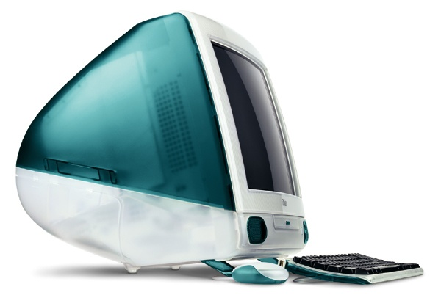


Slide 2
9th International CALIBER 2013
Convention on Automation of Libraries in Education and Research Institutions,
Gandhinagar.
March 21-23 2013.
Librarians’ Attitude towards Information Communication Technology in Colleges affiliated to Sant Gadge Baba Amravati University, Amravati. (MS).
Submitted by
Dr. Sachin D. Sakarkar
Librarian
R.R. Lahoti Science College, Morshi
Dist - Amravati (MS) . 444 905.
Ph. 9423425340
(sachin_sakarkar@yahoo.com)
Rushikumar R. Kuralkar
Librarian
Adarsha Science, J. B. Arts & Birla Commerce Mahavidyalaya,
Dhamangaon Rly, Dist – Amravati (MS)
Ph. 9422913772
Email: rkuralkar@rediffmail.com
Blog: rushikuralkar.blogspot.com
.

Slide 3
Introduction
Implementation of Information Communication Technology (ICT) in Libraries totally depend upon proper attitude of ICT trained Librarian. ICT media had widened the limits and bounds of Library.

Slide 4
Related reviews:
1. O.E.L. Eguavoen in the article “Attitude of library staff to the use of ICT : The case of Kenneth Dike library , University of Ibadan, Nigeria”
2. Muhammad Ramzan in the article “Factors affecting librarians' attitudes toward ICT application in libraries”
3. Sachin D. Sakarkar. in the article “A study of library automation in college Libraries affiliated to SGB Amravati University, Amravati”

Slide 5
Aims and Objectives:
To find out professional awareness of librarians towards ICT applications.
To study the attitudes of librarians towards the use of ICT.

Slide 6
Methodology:
Descriptive survey method
Data Collection Tool
-Questionnaire
Questionnaires Distributed | Responses Received
92 | 61

Slide 7
Population and Sample:
The study targeted libraries in colleges affiliated in SGB Amravati University, Amravati. A short structured questionnaire was filed up by the researcher through librarians in various institutions in SGB Amravati University, Amravati.
Districts in SGBAmravati University,A mravati |  | Amravti | Akola | Buldhana | Washim | Yavatmal
Surveyed libraries in SGB Amravati Uni.Amravati |  | 17 | 13 | 12 | 08 | 11
Distribution of Male and Female Librarians | Male | 13 | 09 | 08 | 06 | 08
 | Female | 04 | 04 | 04 | 02 | 03
Qualification of Librarians PG | Male | 11 | 08 | 07 | 06 | 07
 | Female | 02 | 03 | 04 | 02 | 03
Qualification of Librarians Ph.D | Male | 02 | 01 | 01 | 00 | 01
 | Female | 02 | 01 | 00 | 00 | 00

Slide 8
The Purpose of the study :
To identify general characteristics and patterns that exist with regard to the innovativeness of librarians as it relates to the adoption of ICTs.
The study addresses the following questions:
1. How innovative are librarians in relation to their peers in the adoption of information and communication technologies?
2. Do demographic variables affect librarian innovativeness?
3. What implications might the innovativeness of librarians have on the diffusion of innovations within libraries?

Slide 9
Research Tools:
The instrument used for the collection of data on this study was a modified Igberia and Chakrabarti (1990) Computer Anxiety and Attitude towards Microcomputer Utilization (CAATMU) scale and librarians’ attitude questionnaire developed by researcher. This Research tool is in three parts
Part 1: Demographic variables of the respondents.
Part 2: ICT Perceptions of Librarians
Part 3: Attitude toward ICT

Slide 10
Attitude of Librarians:

Slide 11
Attitude of Librarians:

Slide 12
Attitude of Librarians:

Slide 13
Attitude of Librarians:

Slide 14
Attitude of Librarians:

Slide 15
Conclusion
Society demanded well trained Librarian
IT revolution
Fear of Digital Divide
Suggestion
Regional Training Centers

Slide 16

Thank you

