Slide 1
Experience of a Chinese Librarian at WLIC
Ben Gu
National Library of China

Slide 2
My positions in NLC
Acquisitions librarian
Director of acquisitions & cataloging departments (Chinese and foreign)
Director of ISSN China Center
Director of Online Library Cataloging Center

Slide 3
My roles in IFLA
Standing Committee member of the Cataloguing Section, 2005-2013
Secretary of the Cataloguing Section, 2005-2009
ISBD Review Group member, 2007-Present
Editorial Board member, International Cataloguing and Bibliographic Control, 2011-
Editorial Committee member, IFLA Journal, 2011-

Slide 4
My experience in WLIC
Beijing 1996
Copenhagen 1997
Oslo 2005
Seoul 2006
Durban 2007
Milan 2009
San Juan 2011

Slide 5
Interesting Conferences
Seoul, Korea: Asian culture
Durban, South Africa: different cultural experience, especially in some cultural events
Milan, Italy: musical elements in cultural events (opera house and church)
…

Slide 6
Sessions
Open
Opening Session
Closing Session
Cultural Events
Open Programmes
Not very open (with permission)
Standing Committee meetings (observers allowed)
Working Group meetings

Slide 7
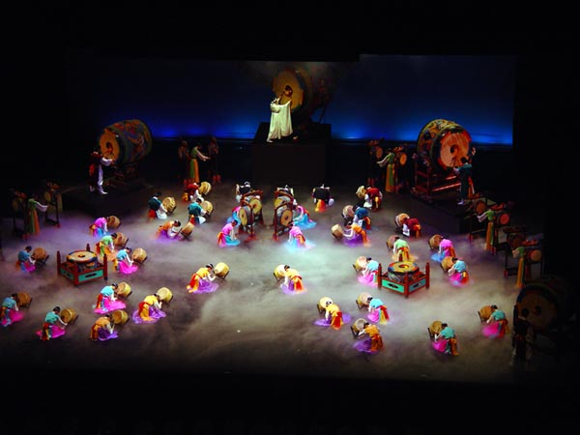
Cultural Evening, Seoul, 2006

Slide 8
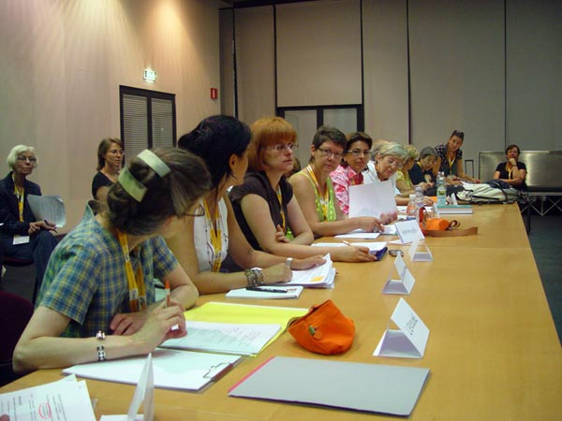
Standing Committee Meeting, 2009

Slide 9
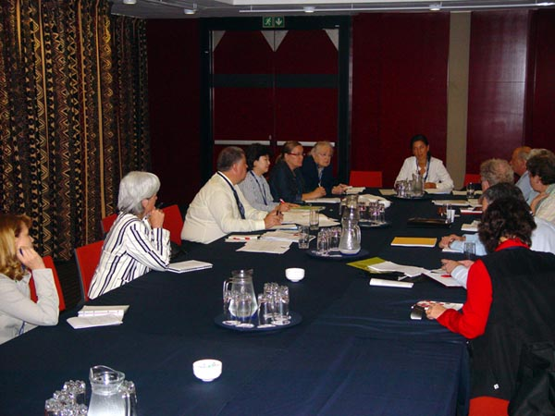
ISBD Review Group Meeting, 2007

Slide 10
Sharing experiences
Photos: Flickr, Facebook, etc.
Blogs: sina.com.cn, Blogspot, etc.
Video: YouTube, etc.
Miniblogs: Twitter, weibo.com, etc.
…

Slide 11
My Blog Posts in Milan, 2009
Day 2: Chinese Language Interpreters
Day 2: Standing Committee Meeting
Day 3: Opening Session, Exhibition and Concert
Day 4: Working Group Meetings
Day 5: ISBD and UNIMARC Meetings
Day 6: Standing Committee, New Book Release, Council Meeting
Day 7: Other Businesses
…

Slide 12
Personal Website
Chinese Translations of Cataloguing-Related Presentations:
http://www.bengu.cn/homepage/library/ifla_chinese_papers_milan2009.htm
Done by Chinese colleagues and organized by me.

Slide 13
Sharing experiences
Translating presentations: Volunteers
Writing reports: Bosses and newsletters
Writing articles: Analyzing presentations and summarizing conferences – Journals and newspapers
Reporting to my colleagues of the National Library of China

Slide 14
Clusions
Make full use of the opportunity:
Professional
Cultural
Communication with international friends
Sharing experiences with librarians unable to attend WLIC

Slide 15
Thank you!
http://blog.sina.com.cn/guben
http://t.sina.com.cn/guben
http://bengu-cn.blogspot.com/
http://www.flickr.com/photos/guben/
https://picasaweb.google.com/benjamin.bengu

