Slide 1
The Guerilla Open Access Movement: What do we know?
Gabriel J. Gardner - California State University Long Beach

Slide 2
The Open Access Battlefield
Per Peter Suber, Open Access:
“isn’t an attempt to reform, violate, or abolish copyright”
“isn’t an attempt to undermine conventional publishing”
“isn’t universal access”
… guerilla open access is all of these
Source: Suber, 2012

Slide 3
How long has this been going on?
1949
Commercial introduction
of
Xerox
photocopier
1969
Laser Printing
introduced
1993
first web browser
available for
Win/Mac
& PDF specification
released
2004
Library.nu, LibGen
predecessor,
created
2009
r/Scholar
created
2011
#icanhazPDF
coined, Sci-Hub
created
1971
first
ARPANET
email
sent

Slide 4
How did we get here? - Read Balázs Bodó
Explosion of college attendance and research production in traditionally less-developed countries
Western commercial scholarly communications infrastructure failed to meet demand
Increased internet penetration allowed previously local sharing efforts to scale up, creating global “black markets”
Source: Bodó, 2016

Slide 5
Means of Liberation
Image credit: “Break through…” by Jakob Lawitzki https://flic.kr/p/BbWdkY

Slide 6
Crowdsourcing
popular front - decentralized

Slide 7
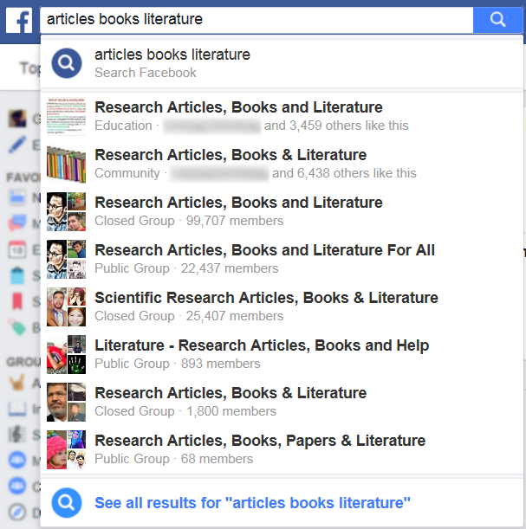
Crowdsourcing: Facebook groups
Closed and public groups
Research Articles, Books and Literature
99,707 members
Scientific Research Articles, Books & Literature
25,407 members
Many more...
Source: Facebook.com Accessed 18 Oct. 2016

Slide 8
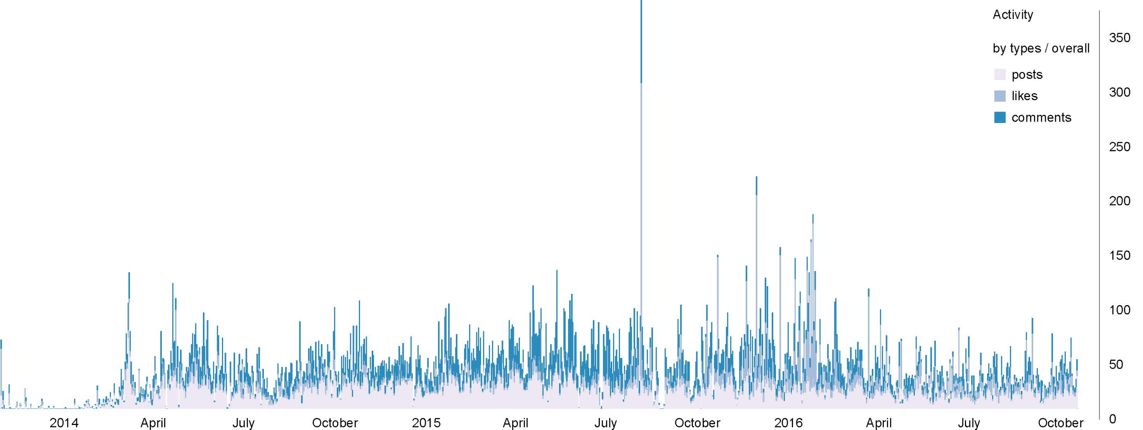
One Facebook example
Public group: ‘Research Articles, Books and Literature For All’
18,791 posts in past 3 years
+14k comments
Average of ~17 posts per day
Steady traffic volume
Source: http://sociograph.io/report.html Accessed 18 Oct. 2016

Slide 9
Crowdsourcing: Reddit r/Scholar
Started in 2009
Files shared via commercial cloud providers
Pseudonyms the norm on Reddit
Promotes LibGen and Sci-Hub
Many “long tail” requests

Slide 10
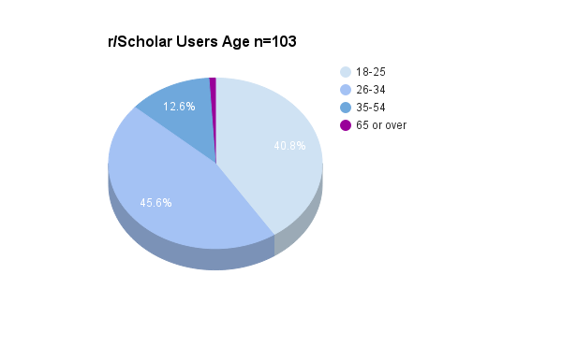
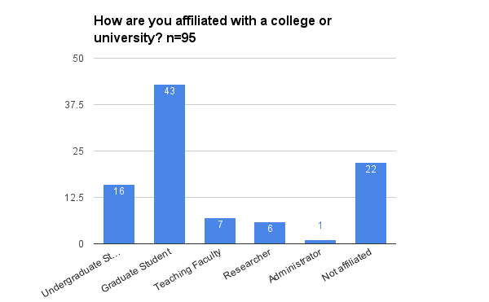
r/Scholar: demographics
Younger user base than Twitter’s #icanhazPDF
Source: Charts based on data from Gardner & Gardner, 2017

Slide 11
r/Scholar growth
Over 28,000 subscribers
Steady growth of approx. 3795/year
One of the top 1000 most visited subreddits
Source: http://redditmetrics.com/r/Scholar Accessed 13 Oct. 2016

Slide 12
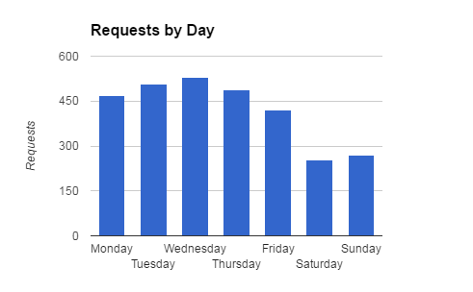
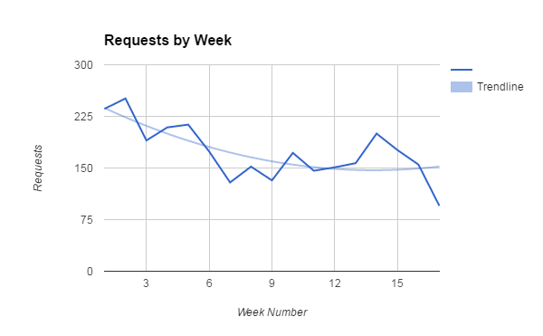
Some r/Scholar figures
2,938 posts during 17 weeks in 2014
Approx. 172 posts/week
1404 unique users
Source: Unpublished data collected by presenter

Slide 13
Crowdsourcing: Twitter #icanhazPDF
~90% of requests are for articles
~30% published within past year
Wide request variety
494 unique journal titles
Heavy usage for biomedicine and health sciences
Source: Gardner and Gardner, 2015; Swab and Romme, 2015

Slide 14
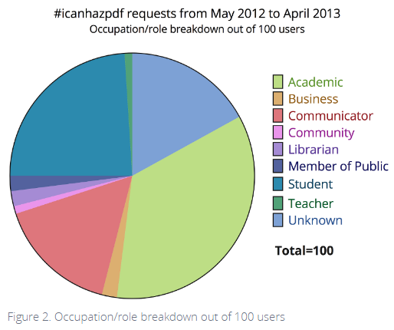
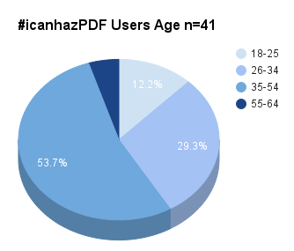
#icanhazPDF: demographics
Sources: Occupation chart copied from Liu, 2013.
Age chart based on data from Gardner & Gardner, 2017.

Slide 15
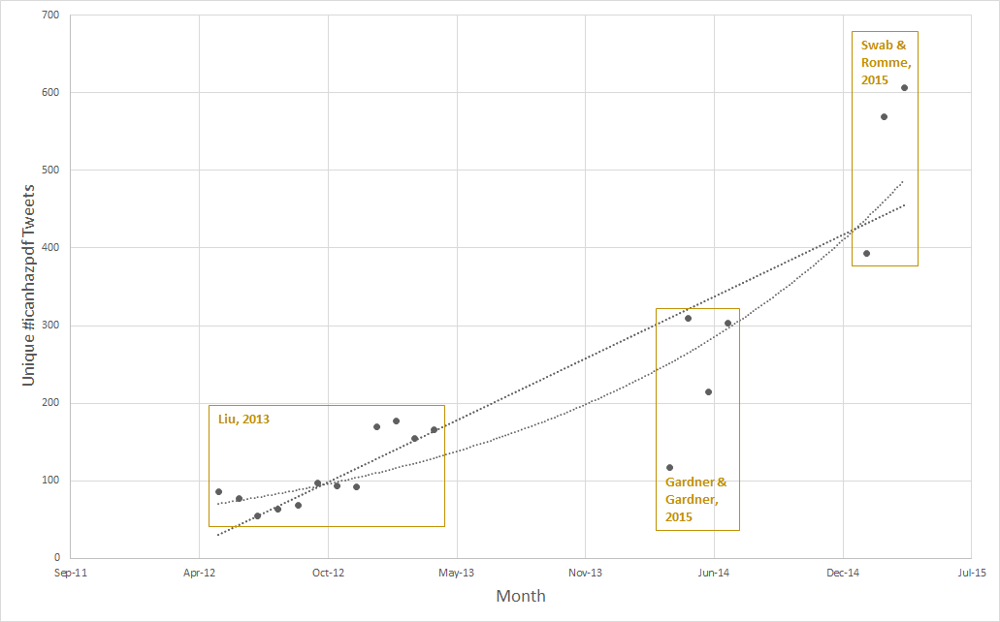
#icanhazPDF usage (no retweets)
Source: open data from cited studies, monthly tabulations not reported in original publications. Data includes conversation and requests.

Slide 16
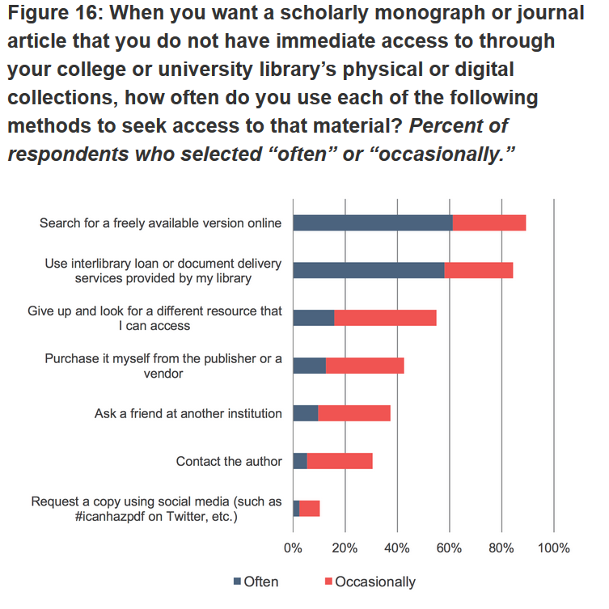
Relatively marginal among faculty
Response n=9,203
~10% ‘Request a copy using social media’
~920
Source: Chart copied from Wolff, Rod, & Schonfeld, 2016

Slide 17
Crowdsourcing: email
“Informal sharing through email or an internal network or sharing print email by personal exchange was the most frequently mentioned method of sharing in both the United Kingdom and the United States.”
Source: Tenopir, 2014

Slide 18
“Pirate” Libraries
revolutionary vanguard - somewhat centralized

Slide 19
The pirate division of labor
Advocate = promotes OA and possibly guerilla OA
Prospector = scouts databases to pirate
Scribe = shares private collections
Courier = moves or distributes content across platforms
Innkeeper = hosts and disguises the Armorer
Armorer = writes scripts to liberate content
Sapper = attempts to penetrate security to allow outside access
Traitor = has legitimate access and uses it to liberate content
Custodian = preserves and organizes content
Archivist = fix metadata problems, writes documentation
Source: The Open Access Guerilla Cookbook

Slide 20
AvaxHome <title>eBooks &amp; eLearning | AvaxHome</title>
Global rank: 280,450
down from 2,501 in 2015
Country | Percent of Visitors | Rank in Country
Japan | 12% | 76,157
Germany | 9.7% | 53,257
France | 9.2% | 37,523
Italy | 6.7% | 47,198
United States | 6.2% | 172,387
Source: Alexa Internet http://www.alexa.com/siteinfo/avxhome.se Accessed 20 Oct. 2016

Slide 21
AvaxHome: speculative demographics
Mostly male
Mostly highly educated
Source: Alexa Internet http://www.alexa.com/siteinfo/avxhome.se Accessed 20 Oct. 2016

Slide 22
LibGen <title>Library Genesis</title>
Global rank: 3,260
up from 23,424 in 2015
Country | Percent of Visitors | Rank in Country
China | 23% | 1,055
United States | 9.5% | 4,446
India | 7.4% | 3,306
Iran | 6.5% | 802
Brazil | 4.4% | 2,134
Source: Alexa Internet http://www.alexa.com/siteinfo/libgen.io Accessed 20 Oct. 2016

Slide 23
LibGen: speculative demographics
Mostly male
Mostly highly educated
Source: Alexa Internet http://www.alexa.com/siteinfo/libgen.io Accessed 20 Oct. 2016

Slide 24
Sci-Hub <title>Поиск по DOI на Sci-Hub</title>
Global rank: 3,950
up from 10,529 in 2015
Top 3 publishers: Elsevier, Springer, IEEE (Bohannon, 2016)
Country | Percent of Visitors | Rank in Country
China | 34.4% | 877
Iran | 8.1% | 678
India | 6.2% | 4,112
Brazil | 4.5% | 2,854
Japan | 3.2% | 6,830
Source: Alexa Internet http://www.alexa.com/siteinfo/sci-hub.cc Accessed 20 Oct. 2016

Slide 25
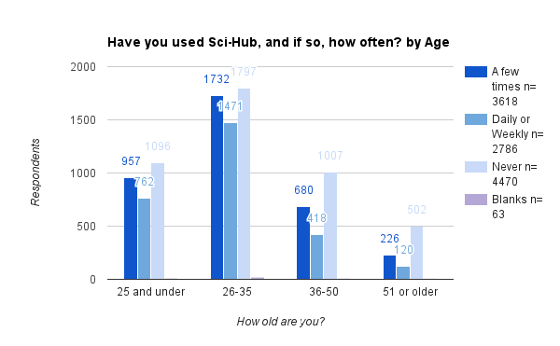
Sci-Hub - age and use: demographics
Source: Results of cross-tab analysis on unpublished data from Travis, 2016

Slide 26
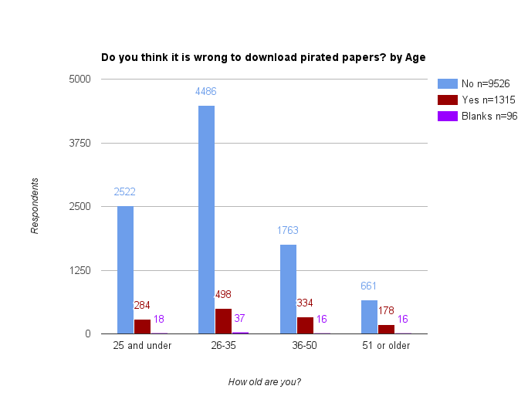
Sci-Hub - age and ethics: demographics
Source: Results of cross-tab analysis on unpublished data from Travis, 2016

Slide 27
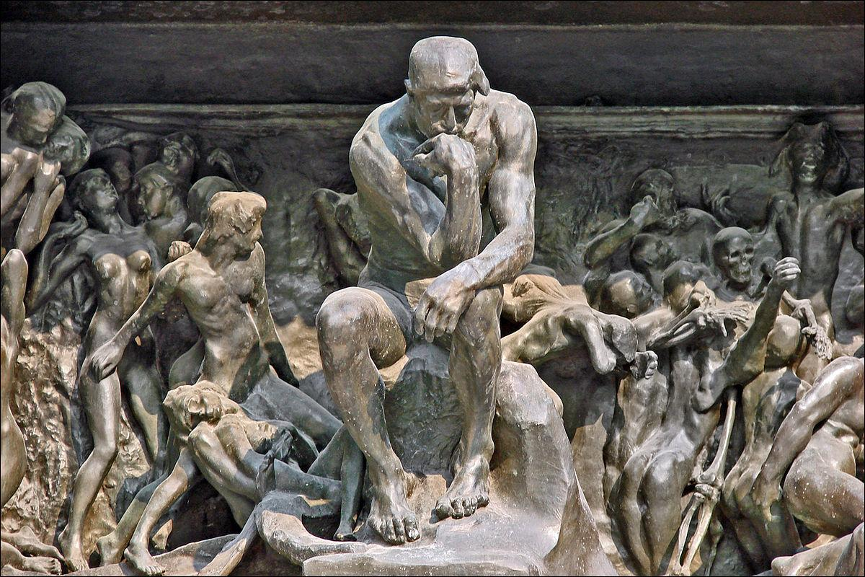
Motives of Liberation
Image credit: “Le penseur de la Porte de l'Enfer” by Jean-Pierre Dalbéra https://flic.kr/p/7U9tzh

Slide 28
“There is no justice in following unjust laws. It’s time to come into the light and, in the grand tradition of civil disobedience, declare our opposition to this private theft of public culture.”
Aaron Swartz
Source: Guerilla Open Access Manifesto. 2008.

Slide 29
“I don't think necessity is the mother of invention — invention, in my opinion, arises directly from idleness, possibly also from laziness. To save oneself trouble.”
Agatha Christie
Source: An Autobiography. 1977.

Slide 30
“I live in Chile and access to the literature (at least certain parts) is extremely patchy.”
Source: Data collected for, though not published in, Gardner and Gardner, 2017

Slide 31
Crowdsourcing: the demand side
Q: “Why do you use r/Scholar, #icanhazpdf, or BitTorrent, to obtain materials?”
Motivations for obtaining materials
Themes | Number of Responses
Access | 76
Speed | 63
User Experience | 48
Cost | 32
Other | 12
Ideology | 11
Source: Table from Gardner and Gardner, 2017

Slide 32
Crowdsourcing: the supply side
“I generally do 2:1 (I give 2 articles the same day I ask for one). I presuppose if I want to receive eventually, I also have to give to maintain community alive” (Categorized for Reciprocity and Community) “My own research would not have been possible without help from these caring, sharing communities. Thus it is natural and right that I should give help back to others in need of access to research literature. The legacy academic publishers (e.g. Elsevier, Wiley, Taylor & Francis, NPG, Springer...) make billions from actively restricting access to research - this kind of civil disobedience is an inevitable and logical response to such ruthless monopolists.” (Categorized for Reciprocity and Ideology/Civil Disobedience) “If you're gonna take, you should give, too, right? Also, I'm a librarian at an academic institution. In the past, as part of my reference shift, I would go through /r/scholar requests and check them against my library's full-text access, filling as many as I could within those time periods. I viewed this as continuing my role to help provide access and furthering the research of others.” (Categorized for Reciprocity and Ideology/Civil Disobedience)
Source: Gardner and Gardner, 2017. Q: Why do you use … to provide materials?

Slide 33
Crowdsourcing: thoughts on ToS/copyright
Q: What are your views regarding the potential violation of copyright or a database’s terms of service that may occur by using r/Scholar, Torrents, or #icanhazPDF?
-----------------------------------------------------------------------------------------
“Meh. we're hardly breaking a multi-billion dollar industry. They'll be fine.” (Categorized for Don’t care)
“I would GLADLY publish my own data for free if there was an easy way to, but my PI and a majority of others maybe don't feel the same way. Yet, they accept these papers I get through r/scholar with no regrets. Data should be free, and putting copyright on data to lock it away is disgusting.” (Categorized for Information should be free)
“If the companies didn't suck (especially since I'm generating the content and acting as a reviewer for others' content, yet still don't get access) I might not feel bad. / / I mean, seriously, my institute's library doesn't even have a subscription to some of major journals in my field we publish in regularly. I've wound up using Reddit Scholar as a faster way of getting /my own/ articles.” (Categorized for Animus towards publishers)
Source: Gardner and Gardner, 2017

Slide 34
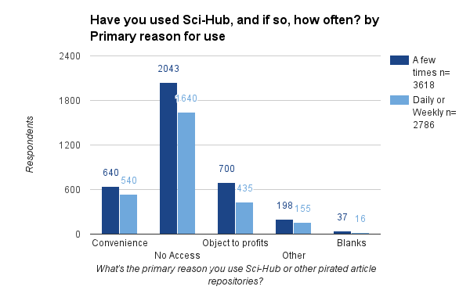
Sci-Hub - reason and use
Source: Results of cross-tab analysis on unpublished data from Travis, 2016

Slide 35
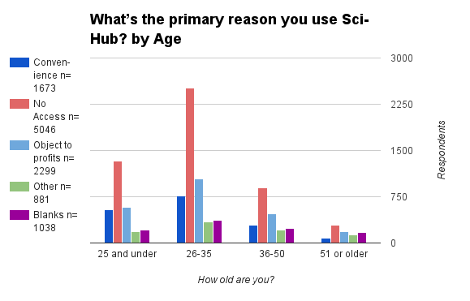
Sci-Hub - age and reason
Source: Results of cross-tab analysis on unpublished data from Travis, 2016

Slide 36
Sci-Hub - “Other” response anecdotes
“As a last resource, if I don't have access and If any of my colleagues around the world can manage to get access and provide me the article.”
“I haven't... but I think the publishers are killing the goose that lays the golden egg by charging too much... people will (and have) found another way. If they made it more affordable, it would be easier for people to just pay it and go on than find a way to steal it.”
“I am a librarian who believes in Open Access and have used SciHub to obtain papers for students that our University library does not have access to.”
Source: Unpublished data from Travis, 2016

Slide 37
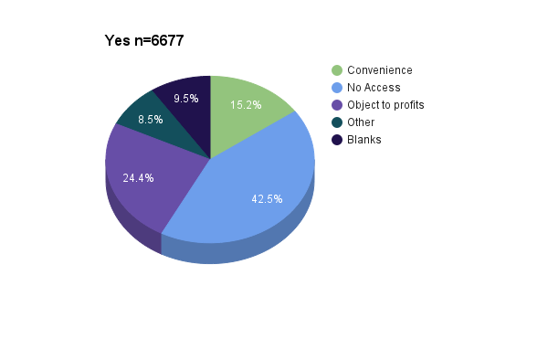
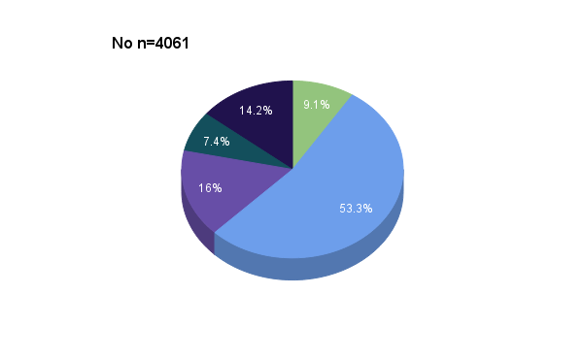
Do you think SciHub will disrupt the traditional science publishing industry?
Most naysayers lack access
Source: Results of cross-tab analysis on unpublished data from Travis, 2016

Slide 38
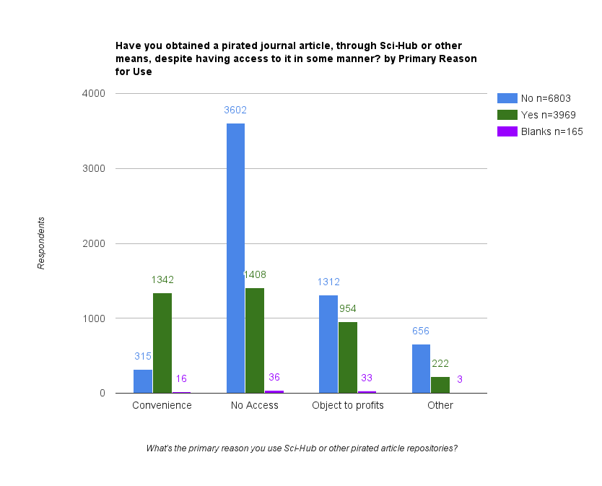
Sci-Hub - for +36% of respondents, it isn’t just about access
Source: Results of cross-tab analysis on unpublished data from Travis, 2016

Slide 39
Unanswered questions - for libraries
How many guerilla transactions could/should take place through an existing library?
60% of Sci-Hub downloads in Utrecht were available via Utrecht University Library subscriptions. (Kramer, 2016)
How fast and easy would ILL need to be to compete with guerilla fulfillment?
...with Sci-Hub?
What public “position” should libraries take?
Should libraries (as institutions) be bringing any attention to this?

Slide 40
Unanswered questions - for scholcommers
How should the open access movement relate to the guerillas?
Will the guerillas push the publishers in a more draconian direction?
Two factor authentication
DRM in PDFs
Killing PDF availability
“A PDF is a weapons-grade tool for piracy,” - Joe Esposito
“Like PDFs? Say goodbye to them.” - Angela Cochran

Slide 41
Unanswered questions - big picture
Assume the future of OA to be bright. What is to be done about all the old copyrighted content?
What should be the role of copyright in science and scholarly communication?

Slide 42
"We, of course, will not comply with the decision of the American court and we are continuing to work. … We will fight for the fact that all the scientific literature, including books and articles, will be available for free on our site.
Alexandra Elbakyan
Source: Ruptly TV, https://youtu.be/w8p-B_u7GiU

Slide 43
Credits
Presentation template by SlidesCarnival
Bodó, Balázs. "Pirates in the Library – An Inquiry into the Guerilla Open Access Movement." Paper prepared for the 8th Annual Workshop of the International Society for the History and Theory of Intellectual Property, CREATe, University of Glasgow, UK, 6-8 July 2016, https://ssrn.com/abstract=2816925.
Bohannon, John. “Who’s Downloading Pirated Papers? Everyone.” Science, 28 Apr. 2016, http://www.sciencemag.org/news/2016/04/whos-downloading-pirated-papers-everyone.
Cochran, Angela. “A Funny Thing Happened on the Way to OA.” Scholarly Kitchen, 25 Feb. 2016, https://scholarlykitchen.sspnet.org/2016/02/25/a-funny-thing-happened-on-the-way-to-oa/.
Esposito, Joseph. “Sci-Hub and the Four Horsemen of the Internet.” Scholarly Kitchen, 2 Mar. 2016, https://scholarlykitchen.sspnet.org/2016/03/02/sci-hub-and-the-four-horsemen-of-the-internet/.
Gardner, Carolyn Caffrey, and Gabriel J. Gardner. “Bypassing Interlibrary Loan Via Twitter: An Exploration Of#icanhazpdf Requests.” Creating Sustainable Community: The Proceedings of the ACRL 2015. Portland, OR: Association of College and Research Libraries, 2015. 95–101. http://www.ala.org/acrl/sites/ala.org.acrl/files/content/conferences/confsandpreconfs/2015/Gardner.pdf
Gardner, Carolyn Caffrey, and Gabriel J. Gardner. “Fast and Furious (at Publishers): The Motivations behind Crowdsourced Research Sharing.” College & Research Libraries, preprint, 2017, http://crl.acrl.org/content/early/2016/02/25/crl16-840.
Kramer, Bianca. “Sci-Hub: Access or Convenience? A Utrecht Case Study (Part 2).” I&M / I&O 2.0, 20 June 2016, https://im2punt0.wordpress.com/2016/06/20/sci-hub-access-or-convenience-a-utrecht-case-study-part-2/.
Liu, Jean. "Interactions: The numbers behind# icanhazpdf." Altmetic Blog, 9 May 2013, https://www.altmetric.com/blog/interactions-the-numbers-behind-icanhazpdf/.
“The Open Access Guerilla Cookbook.” 2013, https://archive.org/details/open.access.guerilla.cookbook.
Ruptly TV. “Meet the 'Robin Hood of Science' - Sci-Hub's Alexandra Elbakyan.” YouTube, 20 Feb. 2016, https://youtu.be/w8p-B_u7GiU.
Suber, Peter. Open Access. The MIT Press, 2012, doi:10.1109/ACCESS.2012.2226094.
Swab, Michelle, and Kristen Romme. “#icanhazpdf? User Requests for Medical Literature on Twitter.” CHLA-ABSC Conference, 19-22 June 2015, Vancouver, BC, 2015, http://conference.chla-absc.ca/sessions/user-requests-medical-literature-twitter-0.
Swartz, Aaron. “Guerilla Open Access Manifesto.” Eremo, Italy, July 2008, https://archive.org/stream/GuerillaOpenAccessManifesto/Goamjuly2008_djvu.txt.
Tenopir, Carol, et al. "To Boldly Go Beyond Downloads: How Are Journal Articles Shared and Used?." 34th annual Charleston conference: Issues in book and serial acquisition. Charleston, SC. 2014, https://libraryconnect.elsevier.com/sites/default/files/CHS14_beyonddownloads_tenopir_hughes.pdf.
Travis, John. “In survey, most give thumbs-up to pirated papers.” Science, 6 Jun. 2016, http://doi.org/10.1126/science.aaf5704.
Wolff, Christine, Alisa B. Rod, and Roger C. Schonfeld. "Ithaka S+R US Faculty Survey 2015." Ithaka S+R., 4 April 2016, http://dx.doi.org/10.18665/sr.277685.

Slide 44
fin
Questions?
You can find me at
gabriel.gardner@csulb.edu
Twitter @7_10_7

