Slide 1
1º Colloquium on Heritage in Sao Paulo Collections
BIBLIOGRAPHIC HERITAGE
Mario Zanini's Art and Library: MAC USP Collection
27/11/2018
Lauci Bortoluci Quintana

Slide 2
Mario Zanini (1907-1971)
Artistic genre: landscape.
Grupo Santa Helena (1930-1940).
Artists (Aldo Bonadei, Alfredo Volpi, Francisco Rebolo).
Collective and artisanal performance.

Slide 3
Landscape paintings by Mario Zanini and the relationship with his Library, exemplified by three volumes: one about Cezanne, one about Van Gogh and one about landscape theory (Lhote).

Slide 4
The artist had insight into integrating his modern art from São Paulo to the process of forming his bibliographic collection. Understanding the library as a process of founding art at the Grupo Santa Helena, due to the primacy of the landscape.

Slide 5
Art Critic – ACCORDING TO WALTER ZANINI
5 PHASes
Since 1923: foreshadowing the landscape, BEGINNING aspects of its language.
1930s: capture of the landscape of São Paulo and its surroundings.
Construction of visual poetics
1940s: moves towards intellectual language of composition, constructive and intellectualized.
1950s: greater rigor in plastic purity. Expression in abstract language.

Slide 6
MATHEY, François. Van Gogh. Paris: Hazan, 1956.
It deals with the trip to Auvers-Sur-Oise in 1890 to be treated by Dr. Gachet. Describes states of depression, sadness and loneliness. The paintings were produced within three months of the Artist's death.

Slide 7
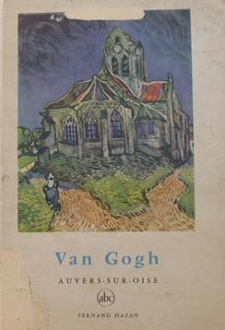
MATHEY, François. Van Gogh. Paris: Hazan, 1956.

Slide 8
JOURDAIN, Francis. Cézanne. Paris: Braun, 1948.
The book features canvas about landscapes, still life and portrait. The author looks back on Cézanne's state of the art and reinforces the idea of ​​painting as something interior.

Slide 9
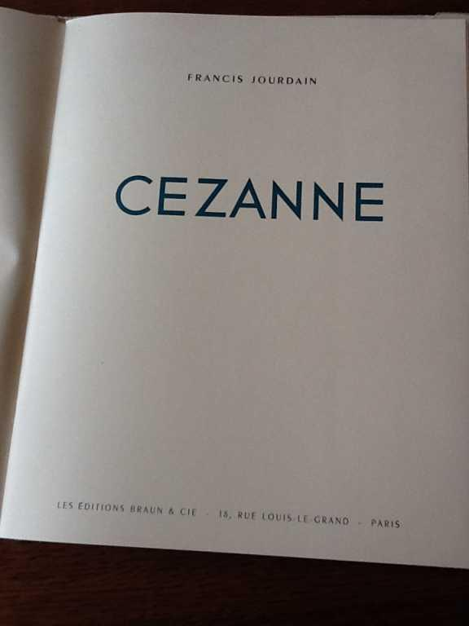
JOURDAIN, Francis. Cézanne. Paris: Braun, 1948.

Slide 10
LHOTE, Andre. Tratado del Paisaje. Buenos Aires: Poseidon, 1943.
The excerpts underlined by reader Zanini recommend plastic procedures that are present in your painting (vibrant colors, freedom in the brush). Zanini's concern was related to the representativeness of the work and the problems of structuring.

Slide 11
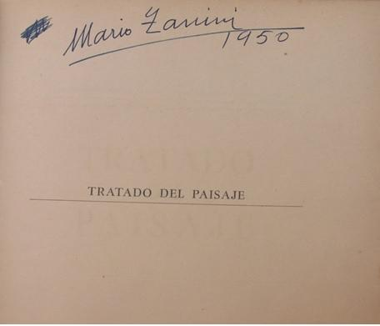
LHOTE, Andre. Tratado del Paisaje. Buenos Aires: Poseidon, 1943.

Slide 12
VISUAL PATH
1930-1950

Slide 13
Barcos carregando lenha, 1936.

Slide 14
The river landscape theme refers to Van Gogh.
Rustic landscape
Rhythmic brush.
Fragmented brush
Light points at the end.

Slide 15
Casas, 1936.

Slide 16
Trecho de linha, 1939.

Slide 17
Spatial organization volume of houses and walls.
Harmony of colors.
Rationalization of the plastic space.
Intellectualized painting.
Visual identifier that illustrates the luminosity that characterizes its language.

Slide 18
Canindé, 1940.

Slide 19
Regatas do Tietê, 1943.

Slide 20
Lerici, 1950.

Slide 21
Lerici is the result of a trip to Italy with Osir and Volpi. The structure solves the movement of forms within space, maintaining the plastic expressiveness.

Slide 22
Patrimônio bibliográfico
WELLS, H.G. Pequena história do mundo. Rio de Janeiro: José Olympio, 1937.

Slide 23
DUMONT, Henri. Degas. New York: Hyperion, 1948.

Slide 24
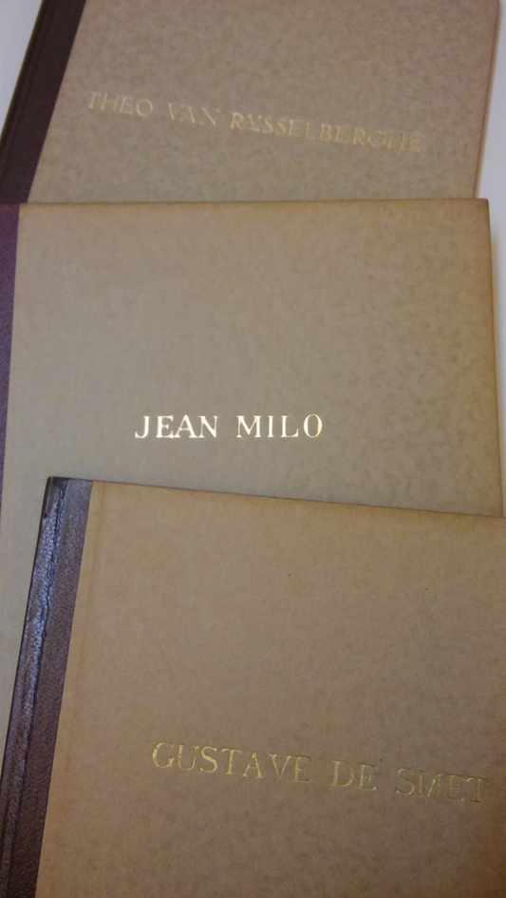
LIVROs SOBRE ARTISTAS BELGAS

Slide 25
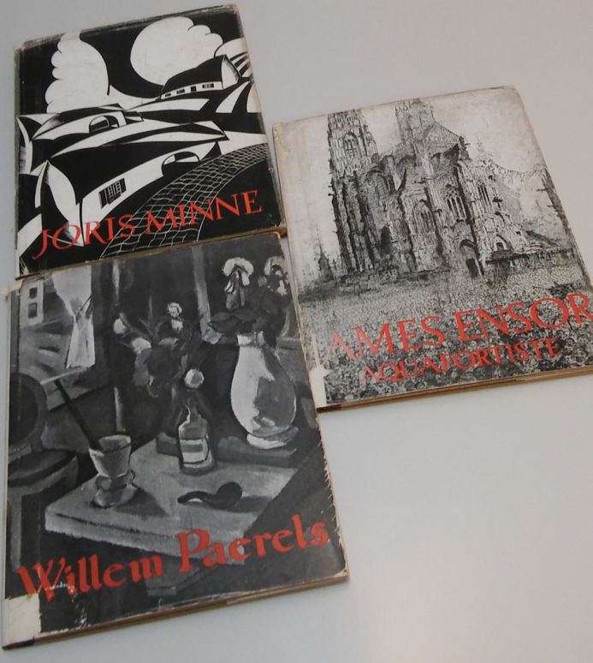
LIVROs da editora de sikkel

Slide 29
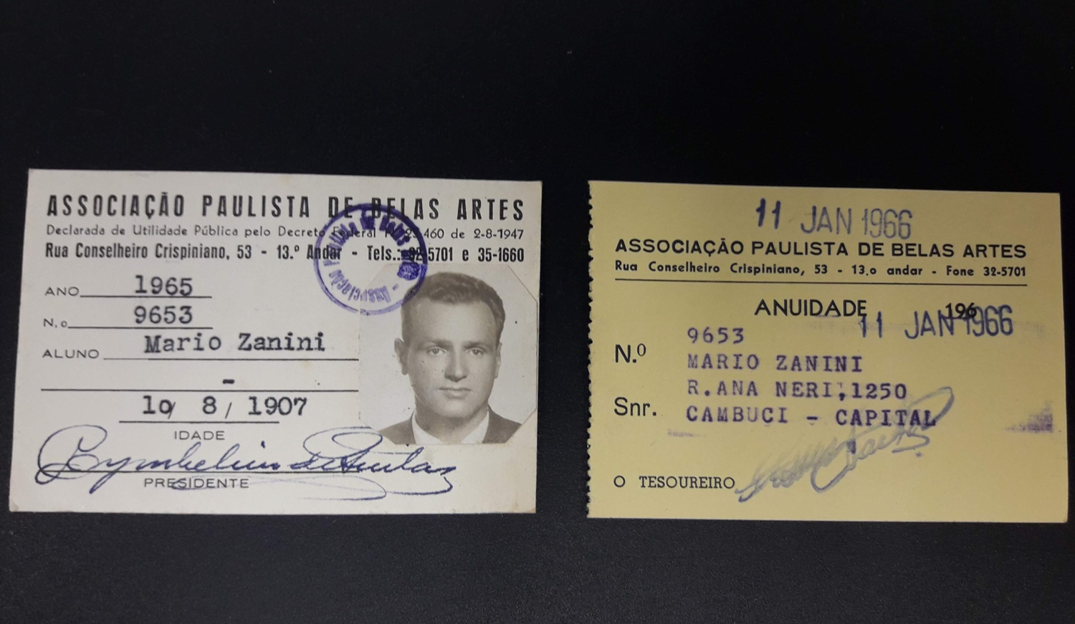

Slide 30
LEGADO
Zanini is in a process of creating a modernity, aesthetics and Brazilian identity from the 1930s to the 1970s. The Sao Paulo’s city landscape shows us his gaze on the process of transforming his reality.
The legacy of books and art works come together to show his personality that discreetly and modestly opens up to new perspectives for understanding art.

