Slide 1
SEMINAR ARCHIVES, HISTORIOGRAPHY AND PRESERVATION: CONTEMPORARY PERSPECTIVES
ART HISTORIOGRAPHY IN MAC USP
Lauci Bortoluci Quintana
FAU USP 26/11/2018

Slide 2
OBJECTIVE
To present the information structure of MAC USP, from two pillars of its collection, the Library and the Archive, to identify approaches related to arts research.

Slide 3
MAC USP Library
Artist Library: Rossi Osir, Mario Zanini, Yolanda Mohaly, Pola Resende
Artist books Collection
Walter Zanini Library and Archive

Slide 4
MAC USP
Bibliographic collection: Books, periodicals, posters, exhibition catalogs, reference catalogs of national and international art.
Individual Catalogs of Collection Artists
External Artist Catalogs
Newspaper Collection

Slide 5
bibliogrAphic heritage
WELLS, H.G. Pequena história do mundo. Rio de Janeiro: José Olympio, 1937.

Slide 6
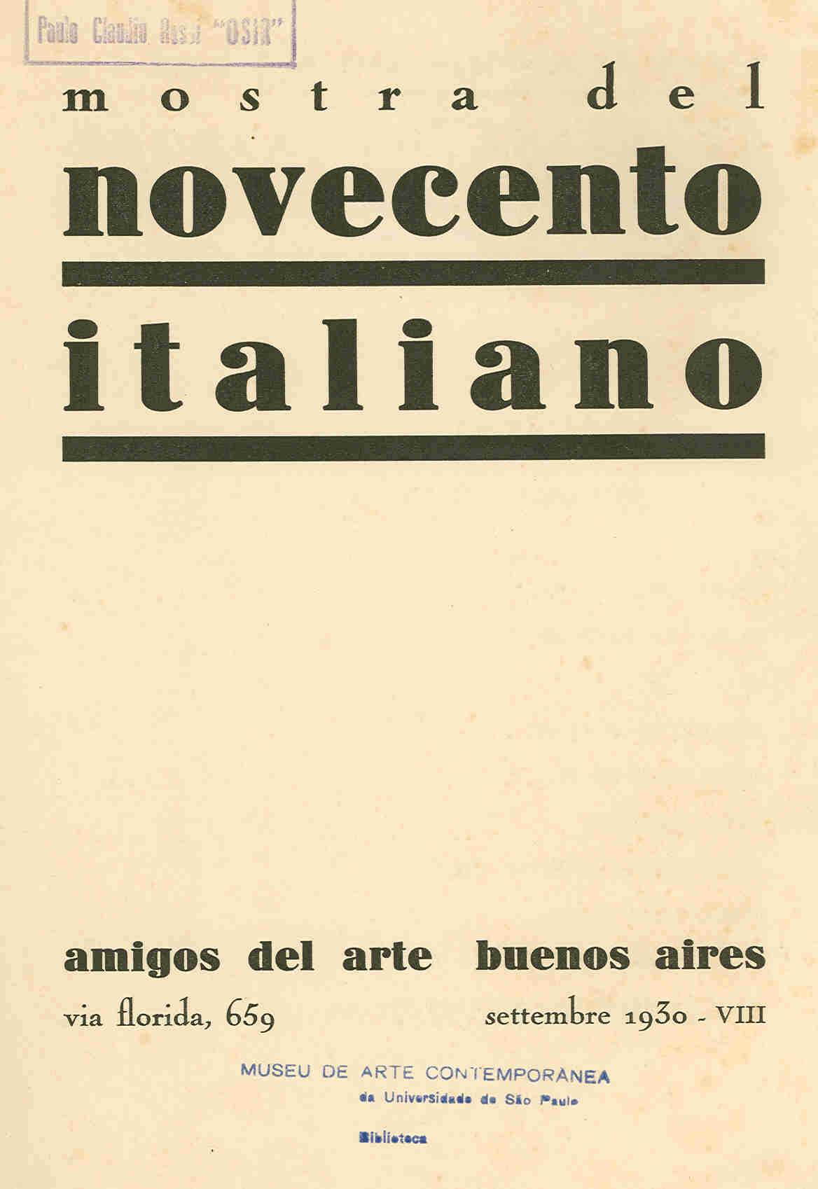

Slide 7
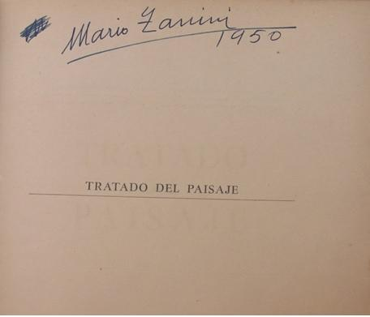
LHOTE, Andre. Tratado del Paisaje. Buenos Aires: Poseidon, 1943.

Slide 8
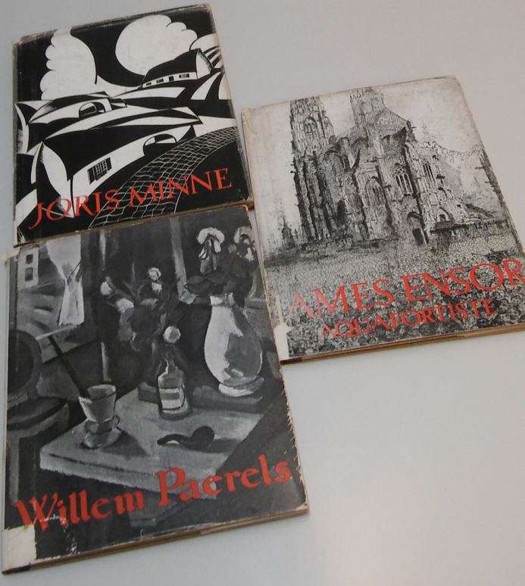
editor de sikkel 1950

Slide 12
ARTISTS BOOKS COLLECTION
Artist book conceptualization is part of a larger whole, which includes all artist publications. This term does not refer only to the book support, but to the printed support in its multiple character and presupposing an edition and circulation. These publications are, in general, supports for the experimentation of new poetics by contemporary artists.

Slide 13
Understanding and cataloging these new formats is crucial to the successful dissemination of information. The productions are configured in print, with limited print editions, through graphic arts resources. Artistic projects use these new formats, proposing new editing, publishing, distribution and circulation procedures.

Slide 14
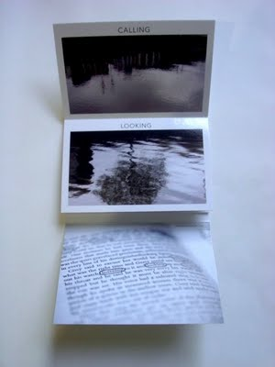
L
Tessler, Elida. Dublin.
Miami, 2010

Slide 15
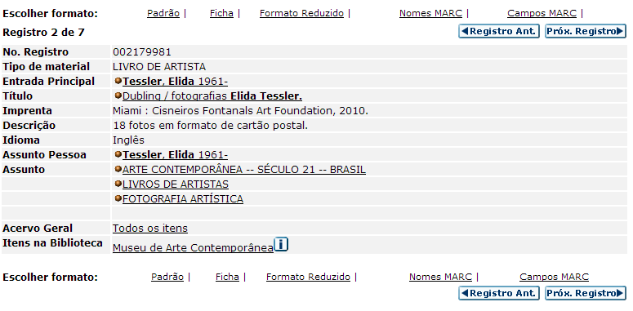
DATA BASE OUTPUT

Slide 16
Artist’books
SILVEIRA, Marcelo. Caixa de Retratos. Recife: Edição de Cariri, 2010. 544 p.

Slide 17
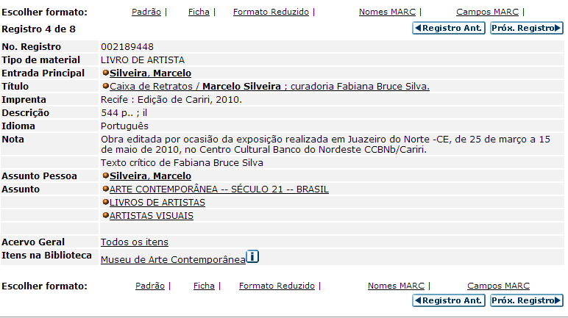
DATA BASE OUTPUT

Slide 18
WALTER ZANINI LIBRARY
Donation made by the Zanini Family, through a process that began in 2013 and was completed in 2018. The collection includes items specialized in History , Modern and Contemporary Art.
The value of this new incorporation is immeasurable. it was compiled, organized and constituted by Walter Zanini himself, the collection shows the course of his intellectual formation, constituting a legitimate social indicator of his studies and interests through the collected works.
The incorporation of the WZ Library into the museum prevented its dispersal.

Slide 19
BIBLIOTECA WALTER ZANINI

Slide 20
MAC USP ARCHIVE
The archive's mission is to organize, preserve and disseminate the documentation resulting from the institution's middle and end activities, as well as the private archives and collections. The archival collection consists of textual, iconographic, sound and audiovisual documents.

Slide 21
MAC USP ARCHIVE
Bulletins
Exhibtion Catalogue MAC
posters MAC
Dossiês
Historicals documents

Slide 22
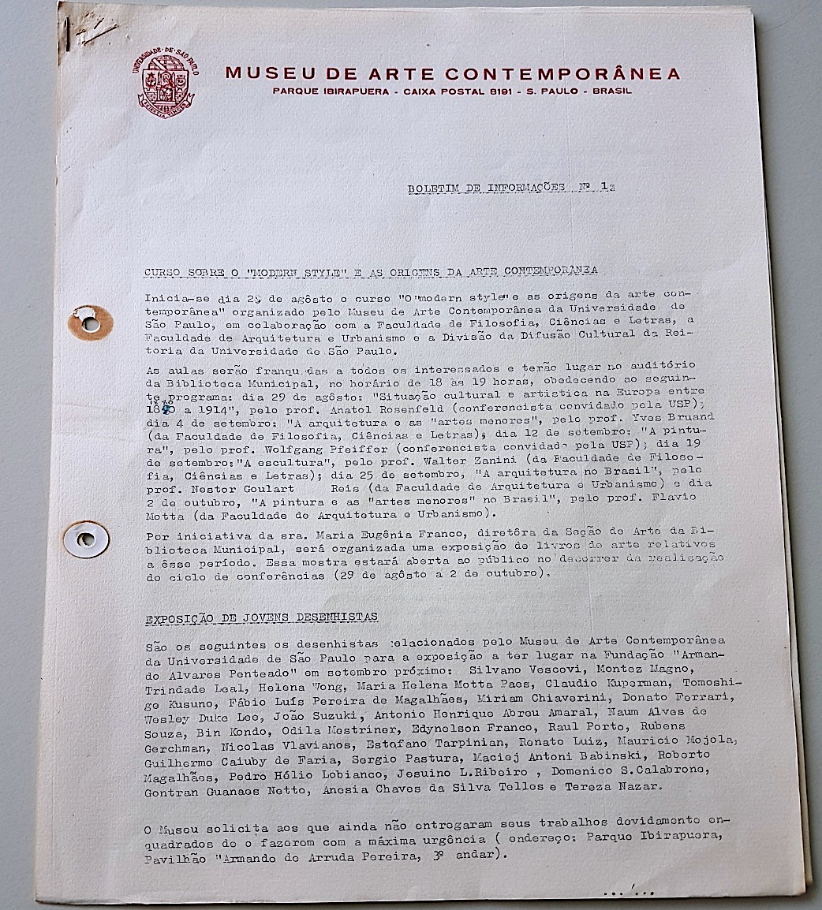
Bulletin n. 1

Slide 23
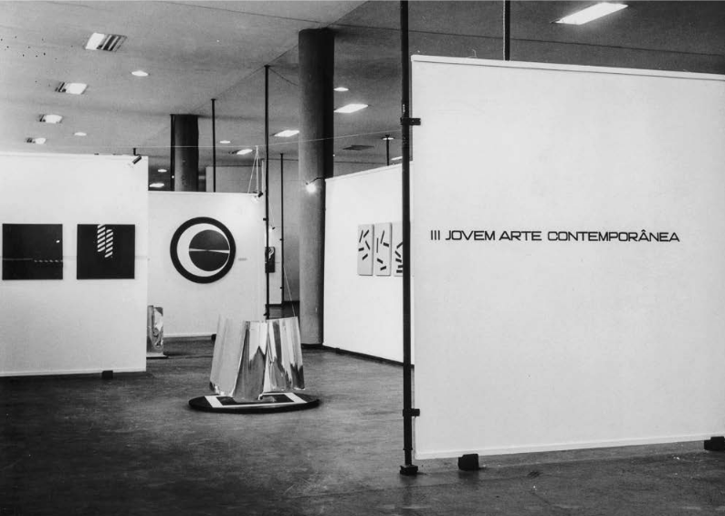
. Exhibition Photographs
Exhibition photographs are an important source of research for the Archive and are part of the Exhibition Dossiers, with relevant information for each event itself. It is a documentation that has been arousing more interest from researchers.

Slide 24
MAC USP AND COLLABORATIVE RESEARCH
The Museum's two informational loci work together to respond to research demands of artists, teachers, students, curators, and researchers in general.
The artist's book collection is a good example of how the institutional structure needs to be flexible to receipt of a type of material previously unplanned in the canonical frameworks of information handling.

Slide 25
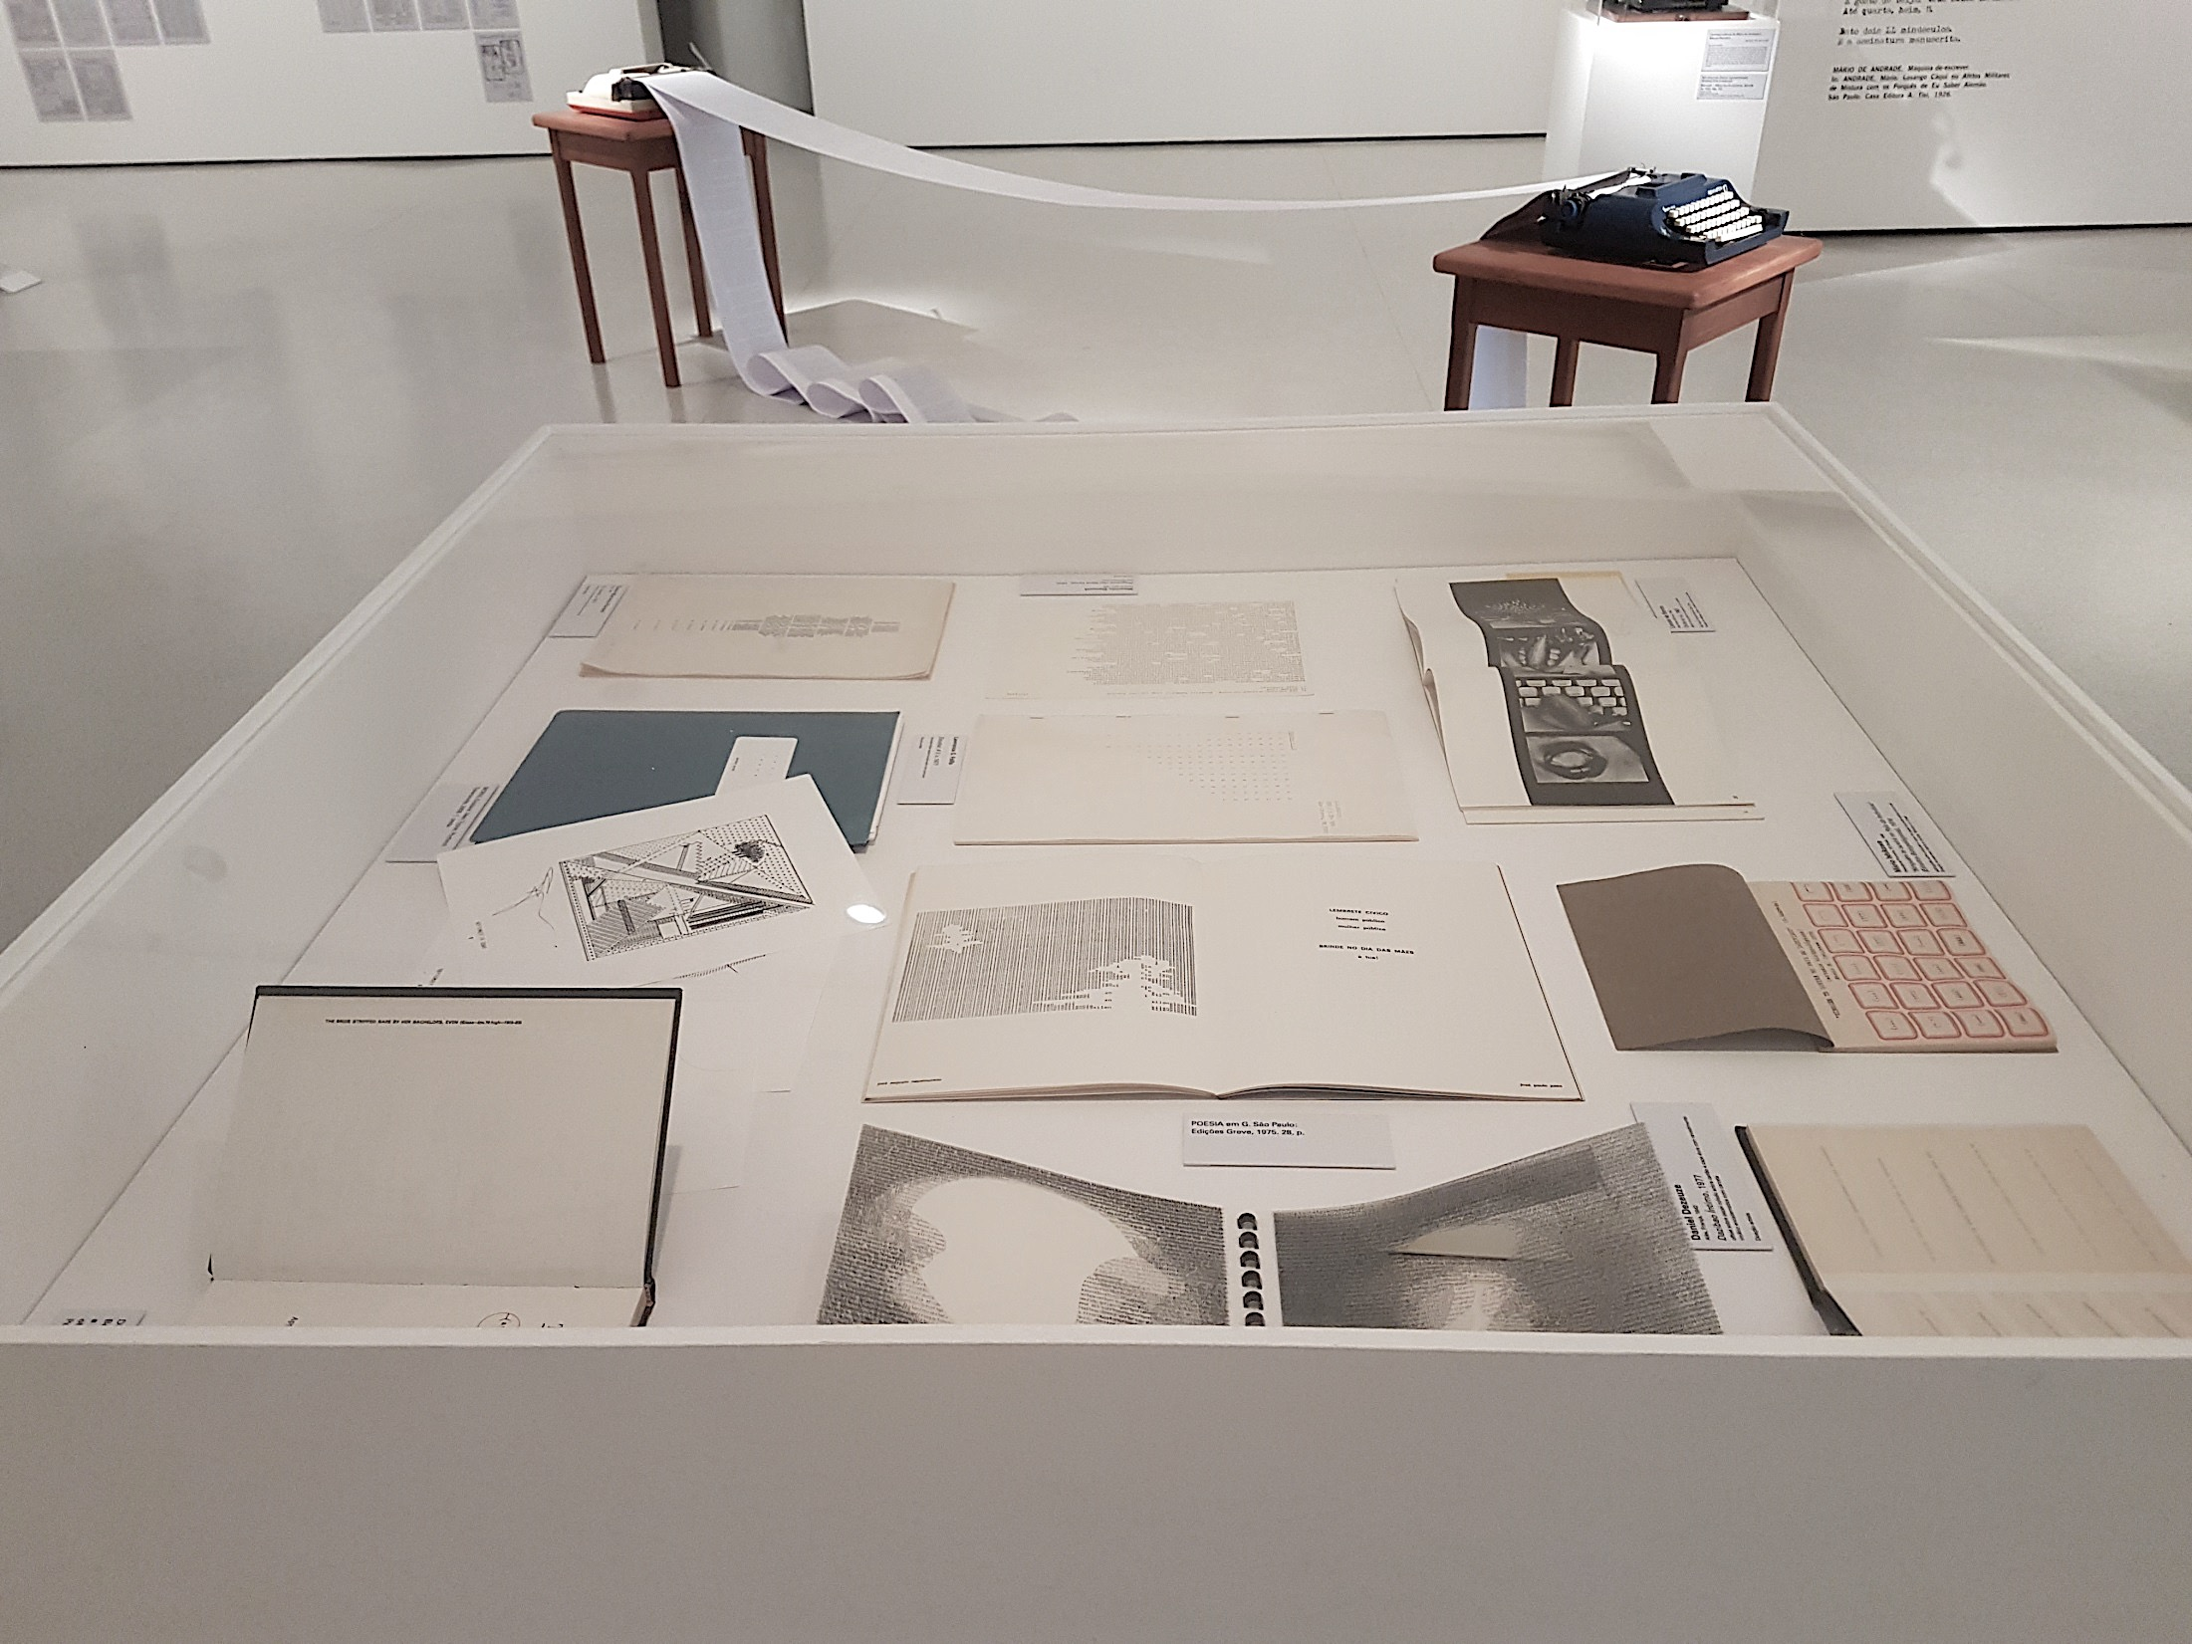

Slide 26
Archival and bibliographic information complement each other as an institutional memory, opening up new models of access and assistance to the researcher.

Slide 27
RESEARCH IN ACTION
The MAC USP Archive and Library come together to support the research of teachers, the results of which will be expressed on the tripod of undergraduate, postgraduate and cultural extension.

Slide 28
MUSEUM IN CHANGE: experiment locus
The Walter Zanini Library has potential for establishing new paradigms in the treatment of bibliographic and archival collections in the museum, given its intrinsic relationship with the origin of the institution and its early history.

Slide 29
The work of postgraduate researchers at the Zanini Library will be of great value not only for understanding the legacy of this important art historian, but also for the museum's work cataloging the documents.

Slide 30
It is never too much to remind that cataloging / documenting a collection (be it artistic, bibliographic or archival) is not a technical activity. Only through the collaboration of professionals from different specialties is it possible to meet the complexity of documents and the demands of contemporary research.

Slide 31
