Slide 1
Italian artists in Mario de Andrade Collection Rossi Osir influence in Grupo Santa Helena
Lauci Bortoluci Quintana
MAC USP
26/05/2018
Casa Mario de Andrade

Slide 2
The Artist
Born in São Paulo, 1890
Lived in Italy from 2 to 17 years old, where he starts painting
In 1908, he dedicated himself to the study of watercolor in Dover, improving landscape painting. Between 1909 and 1912, he attends the High School of Arts and Crafts in São Paulo

Slide 3
Architect degree in Bologna in 1916
1920, brings the exhibition of Italian Modern Art to São Paulo
1921 and 1922 exhibits watercolors in São Paulo and returns to Europe to study of Art History.
Back definitely to Brazil in 1927

Slide 4
1932 participates in the creation of SPAM
1937 creates and organizes the 1st Salon of the Paulista Artistic Family
1940, created Osirarte
In 1945 creation of Clubinho, Club of Artists and Friends of Art
In 1950, travels with Zanini and Volpi to Europe
In 1951, exhibits at the 1st MAM Biennial
Passes away in 1959

Slide 5
Italian Modern Art
This catalog reveals the Italian reality of that moment. Osir brought the leading macchiaioli artists such as Boldini, Induno, Morelli, Pasini, Dal Bono, Mariani; painters engaged against academic conventions, advocating a new pictorial style and privileging the landscape

Slide 6
The catalog suggests that the understanding about the importance of Rossi Osir in Brazilian art should be shifted from 1937 (FAP) to 1920.

Slide 7
Central Italy
From the Roman school: Henry Serra, Alberto Beniscelli, Renato Tomassi, A. Calcagnadoro, G. Constantini, Pius Joris, Vertunni, Ximenes, Coromaldi, Majuta
Southern Italy
From the Neapolitan school: Morelli, Dal Bono, G. Casciaro

Slide 8
South Italian
Mario Ornatti, Carlo Casanova, Lentini, Filippo Carcano, Giovanni Segantini, Gerolamo Induno, Alberto PasinI, Riccardo Galli, Paolo Sala, Mantegazza, Stefani, Agostini, Savini, Bianchi, De Rubelo, Tom, Rimoldi, Pompeo Mariani, Carlo Maggi, Mascarini, E. Agazzi, Renzo Wais, Fontana, Winderling, Bertolini

Slide 9
South Italian
Venezian: Ettore Tito, Dall’Oca Bianca, Bebbe Ciardi, Laurenti, Bisson, Follini Gachet
Piemonte: Dalleani, Petiti, Morbelli, Buscaglione, Bresciani, Bonzagni, Rivaroli, Laurenzi d’Assisi, Manucci, C. Jrolli, Giovanni Boldini, Scattola, Chialiva, Farini, Marchesi, Annivitti, Carulus Durand, Sanchez Barbudo

Slide 10
Italian cultural context 1920
Appreciation to the past
Return to Classical Civilization and the Renaissance
Importance of metiê
Re-visit to Renaissance Masters
Cultural and political renewal after unification, reintegrating Italy on the European scene

Slide 11
Revealing Paulo Rossi: The Library
1. Publishers and books
2. regionalized culture
3.Paulo Rossi's thoughts

Slide 12
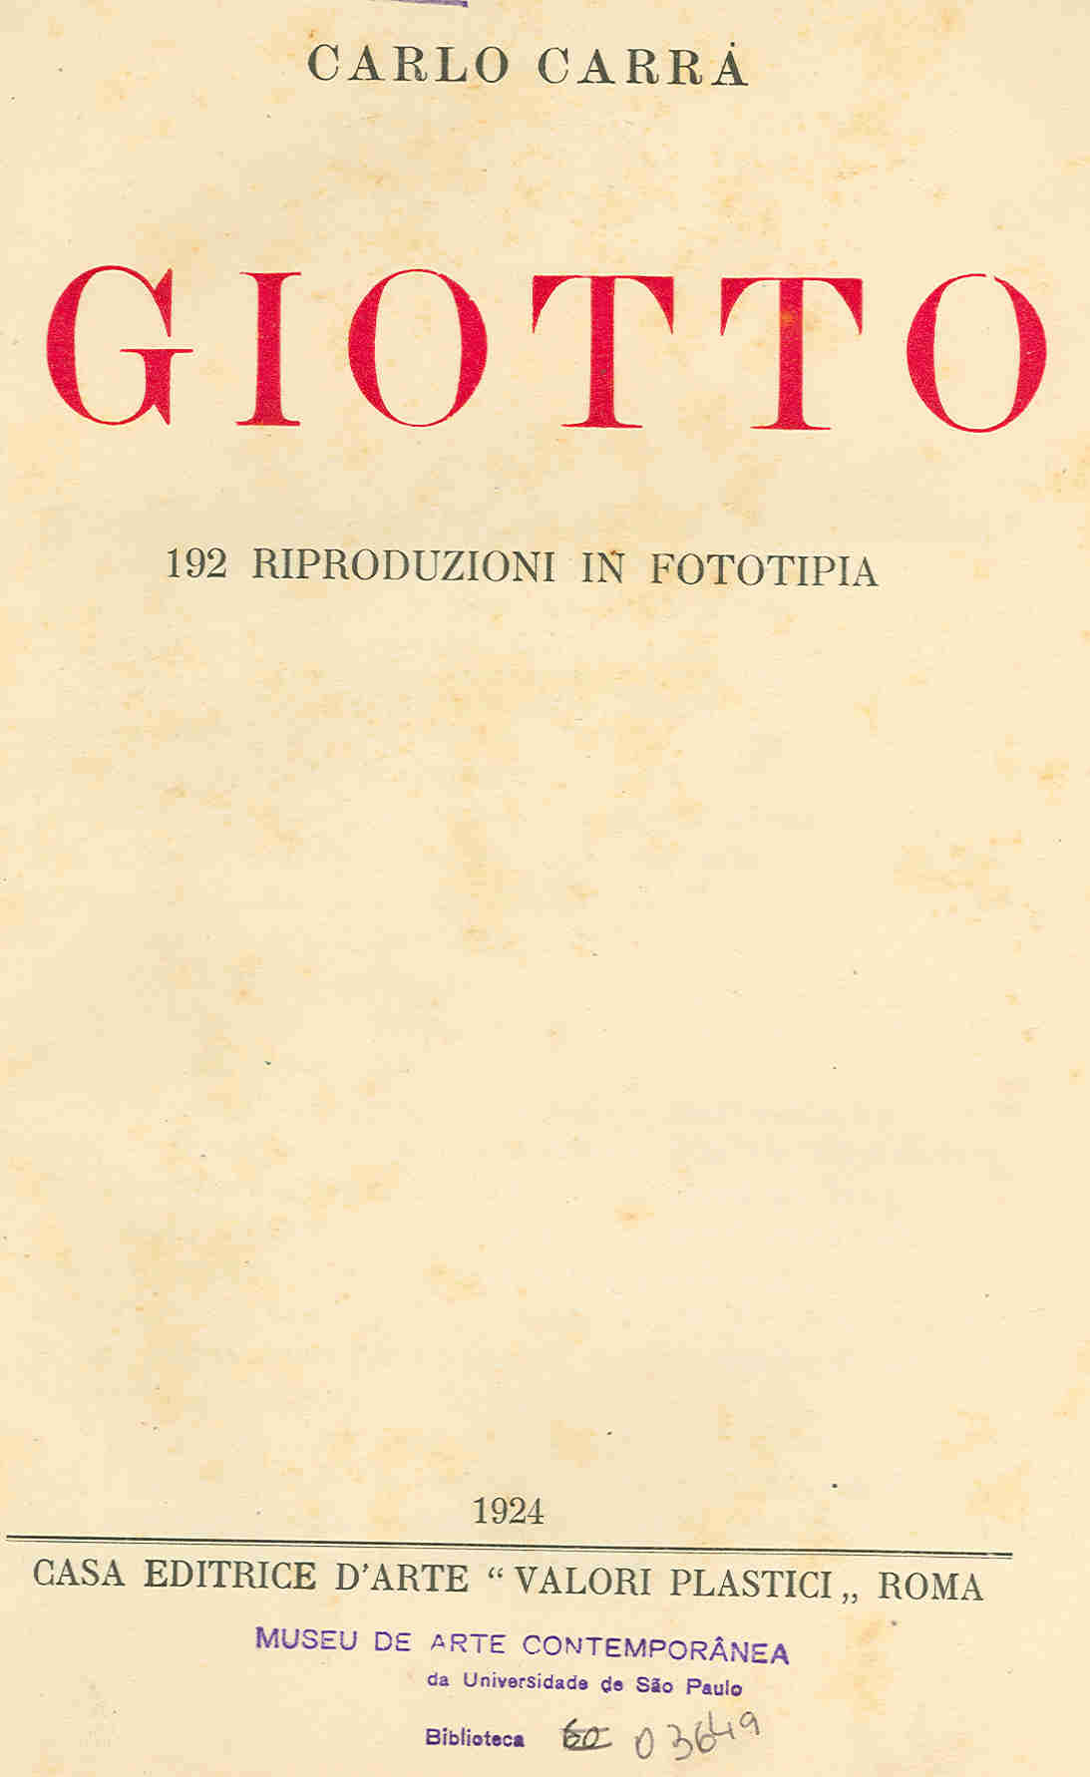
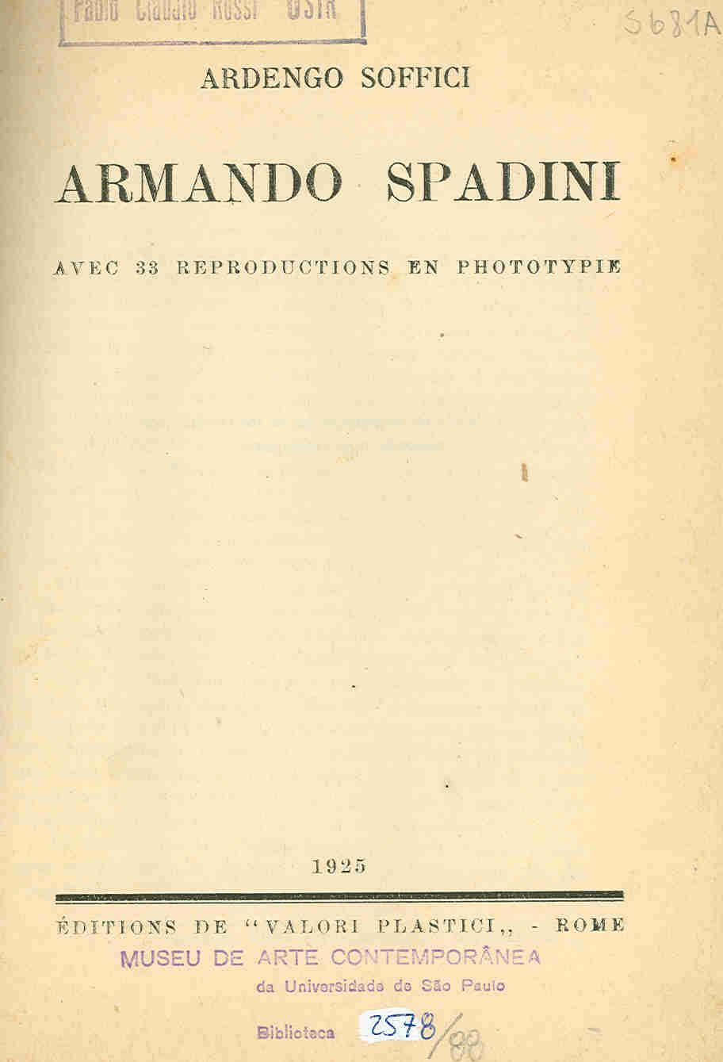
Valori Plastici
Giotto de Carrá (1924)
Armando Spadini de Soffici (1925)

Slide 13
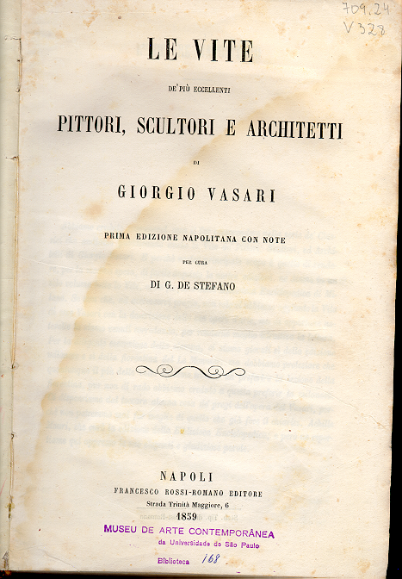
Vasari
Le vite: (1859)

Slide 14
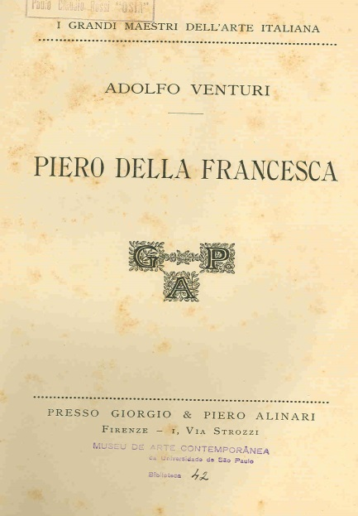
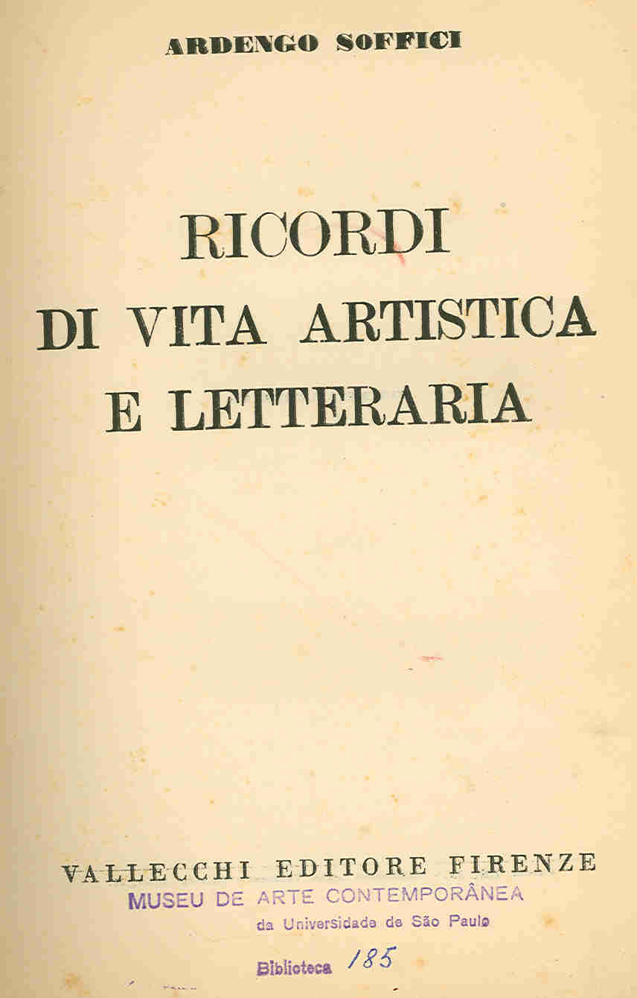
Soffici Venturi
Biografia de Fattori, Bellini, Modigliani Apollinaire, (1931)
Piero della francesca

Slide 15
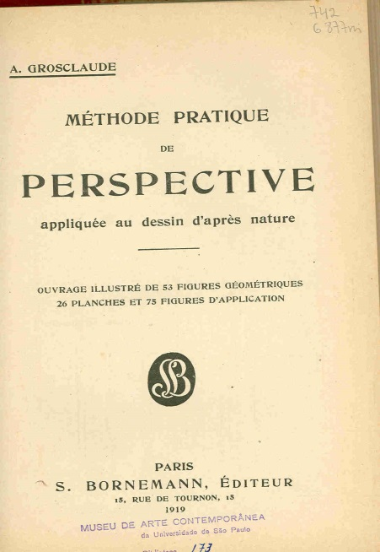
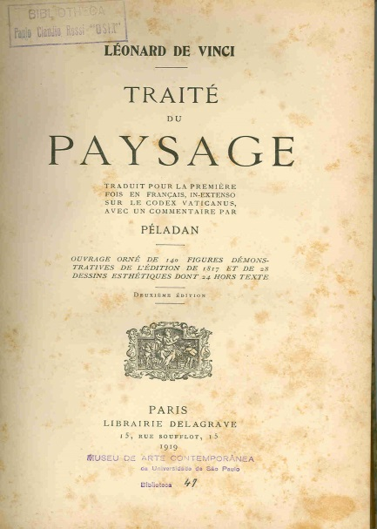
Méthode pratique de perspective de Grosclaude (1919)
Traité du paysage de Da Vinci (1919)

Slide 16
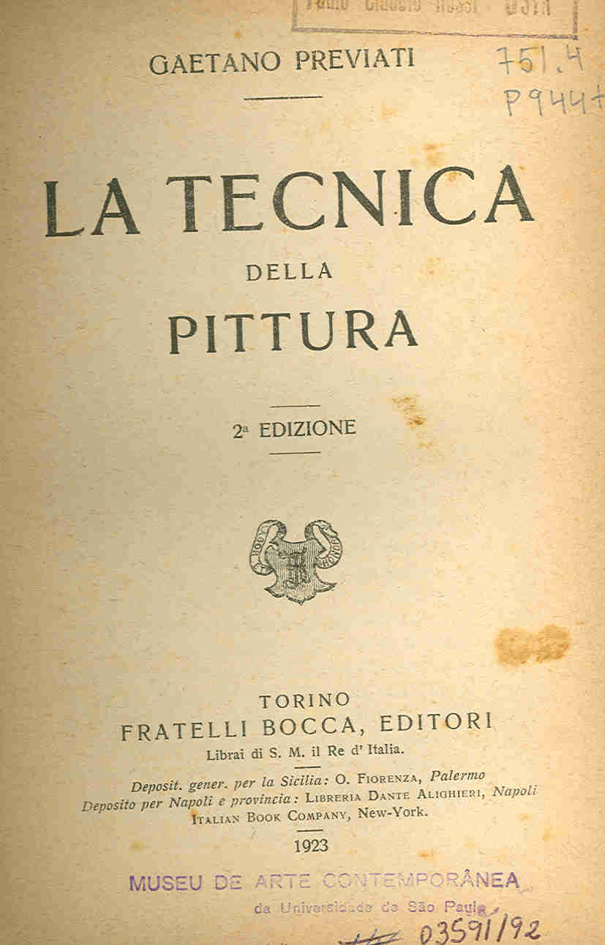
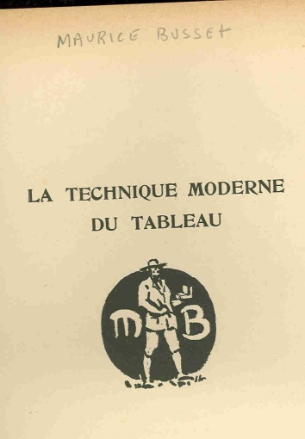
La tecnica della pittura de Previati (1923)
La technique moderne du tableau de M. Busset (1929)

Slide 17
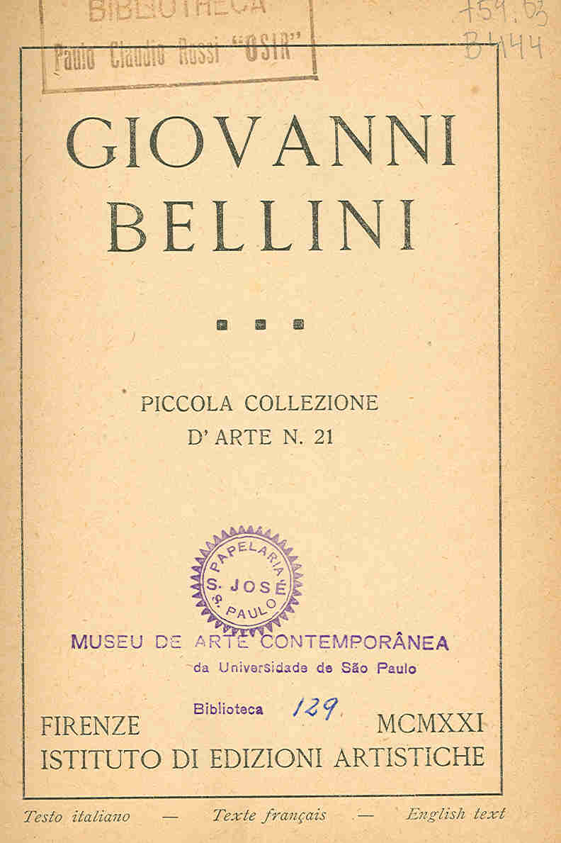
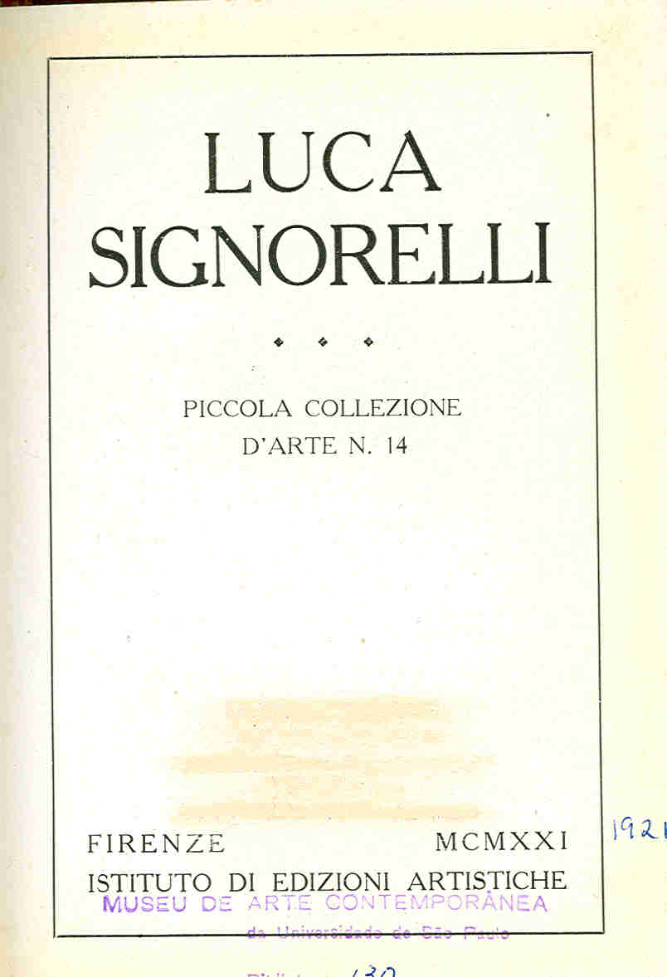
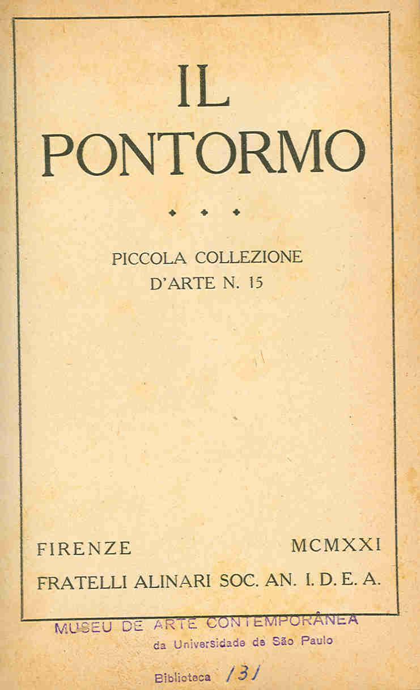
Firenze
Giovanni Bellini (1921)
Luca Signorelli (1921)
Il Pontormo (1921)

Slide 18
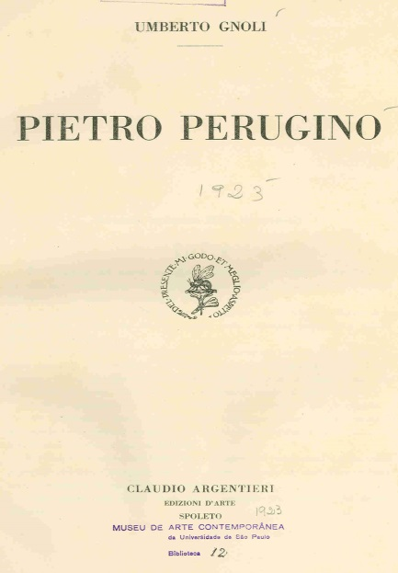
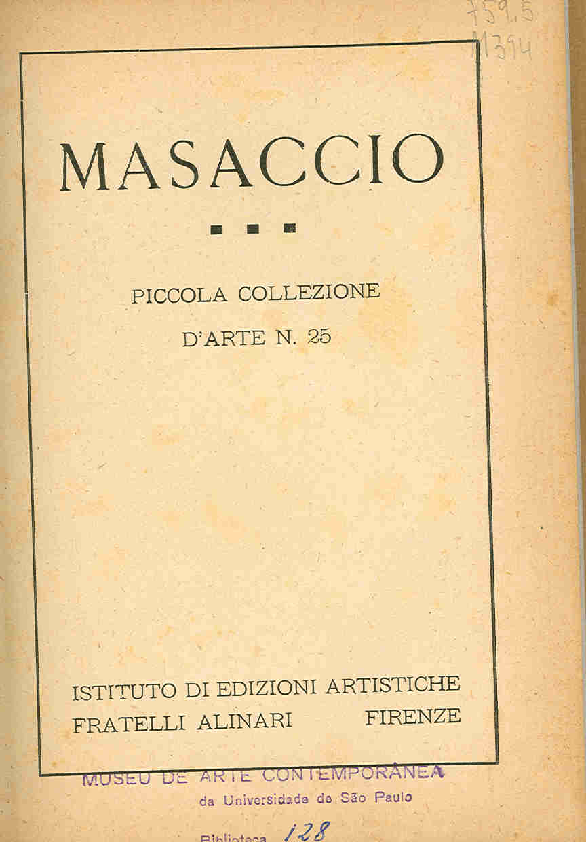
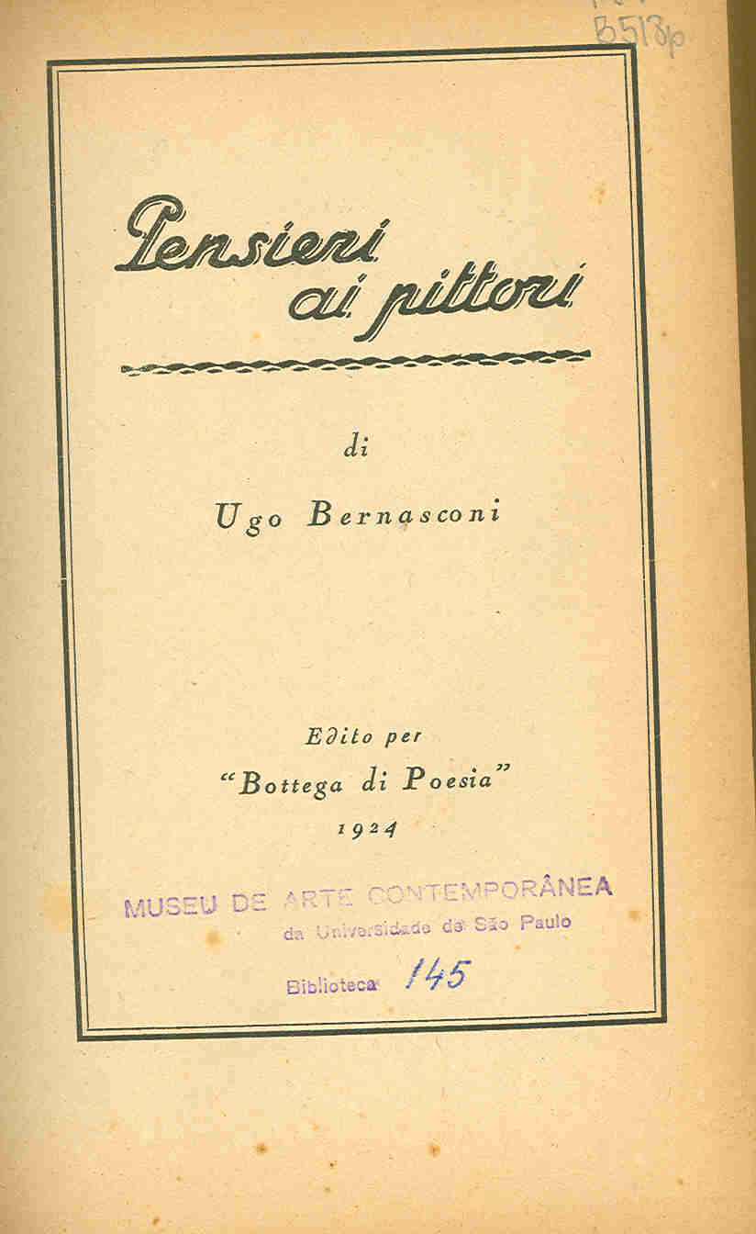
Bolonha
Pietro Perugino de Umberto Gnoli (1923)
Milão
Masaccio de Ugo Bernasconi (1924)

Slide 19
The incentive of modernity in Sao Paulo
The Library brings to its core the contemporary Italian issues, captured by Rossi's humanist sensibility, which was a fundamental factor for the circulation of these ideas among the artists participating in the various movements of São Paulo's modernity, such as the Santa Helena group and the Paulista Artistic Family. which was the mentor

Slide 20
FAP 1937, 1938, 1940
Mario de Andrade and publication of the article “This Paulista Family”

Slide 21
“The arrival and fixation of Victorio Gobbis and Paulo Rossi Osir in the São Paulo environment, men able to talk about the differences in brush strokes of a Raphael and a Titian and knowing what it is to link a color to its neighbor, has softly destroyed both our pictorial illiteracy. It really matters little the temporary appearance of original expressions like Anita or Tarsila's modernism. Such blows were useful, but less fruitful for the plastic orientation of Paulista painting than Paulo Rossi Osir and Victorio Gobbis' thorough, fearful and well-educated traditionalism. ”
ANDRADE, M. Esta paulista família. 1939.

Slide 22
Grupo St. Helena (Pennacchi, Rizzotti, Rebolo, Volpi, Graciano, Zanini, Bonadei, Rosa, Martins): Example of Collectivism and Solidarity
Rossi's dedication to these painters, bringing critics like Mario de Andrade, Sergio Milliet, Paulo Mendes de Almeida to visit the FAP exhibition
Rossi gave full support to the proletarian artists, leaving aside the common prejudice at the time, being one of the few who bet on them.

Slide 23
Rossi had a vast artistic culture, a vast library, and made it available for use of friends. At home, he held art history study at nights. Mario Zanini and Volpi made their first trip abroad promoted by Rossi
Mario de Andrade's diagnosis of the “plastic orientation of painting” corroborates Rossi's attitudes of conveying his experiences of over 30 years of study in Italy

Slide 24
“The truth is, these GSH people lived darkly, until Rossi discovered them. It was Rossi, who had free traffic and the best relations in the highest artistic circles that put them in the window and linked them to critics of the time. He did it because he believed in them, because he was the first to open a credit of trust and admiration to those artists. For them a lot fought. For the truth is that the modernists of the 1920s did not give them credit, did not leave Higienópolis and Avenida Paulista to go to Pça da Sé. ”
ALMEIDA, P. De Anita ao Museu. 1976.

