Slide 1
Zotero
Step-by-Step Guide
By
Ravindra Bankar
Shivaji University Kolhapur
8669155113

Slide 2
About Zotero
1.Zotero is the open source citation manager tool developed by Center for History and New Media at George Mason University.
2.The tool offers users a variety of ways to store, manage, and cite bibliographic references, such as books, journal articles, and websites with a single click and then easily store related PDF’s, images, links ,whole web pages and any other files alongside that information inside your Zotero library.
3. It works as an add-on for chrome/firefox and safari.

Slide 3
Downloading Zotero and Zotero connector.
Integrating Zotero to word.
Creation of folders/collections.
Putting references into library:
a) From websites
b)PDF
c) By identifier
d) Manual entry
IV. Insert referencing in the documents:
a) Insert reference
b) Insert bibliography

Slide 4
Go to website www.zotero.org and download zotero.

Slide 5
Download Zotero connector along-with Zotero Tool

Slide 6
1.Integrate Zotero with word: Open Zotero 1st and click>Tools>Add Ones>Zotero word for Windows Integration
Click here

Slide 7
In next window click word processors tab>Reinstall Microsoft Word Add-in
Click here

Slide 8
Creation of collection folder: open interface>new collection>rename>ok
Click here

Slide 9
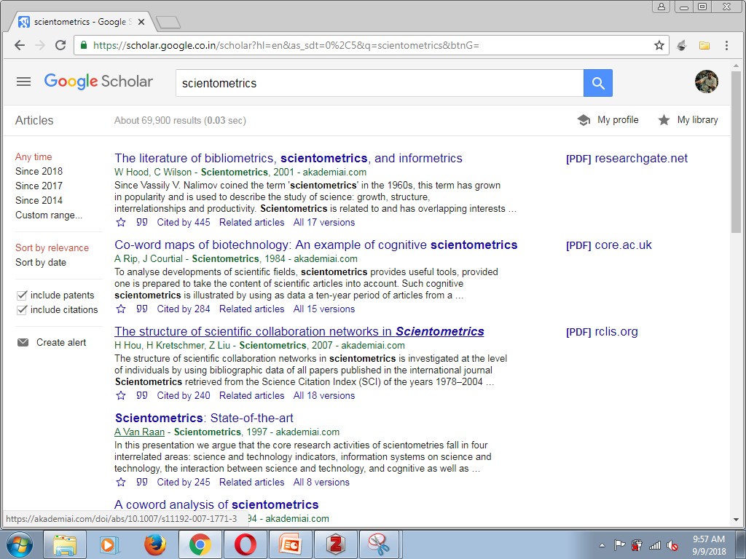
Go to desired website if that page contains zotero icon in extension box of your browser turns to yellow
#Putting references in library: a) From Websites

Slide 10
Click on yellow box and select the particular references you have to add >select collection>ok

Slide 11
Drag and drop your pdf to Zotero tool in specified collection and Zotero will retrieve all the metadata automatically.
#Putting references in library: b) From pdf’s

Slide 12
Click identifier mark and enter ISBN,DOI,PMID and hit enter to automatically retrieve metadata of specific document.
#Putting references in library: c) by identifier
click

Slide 13
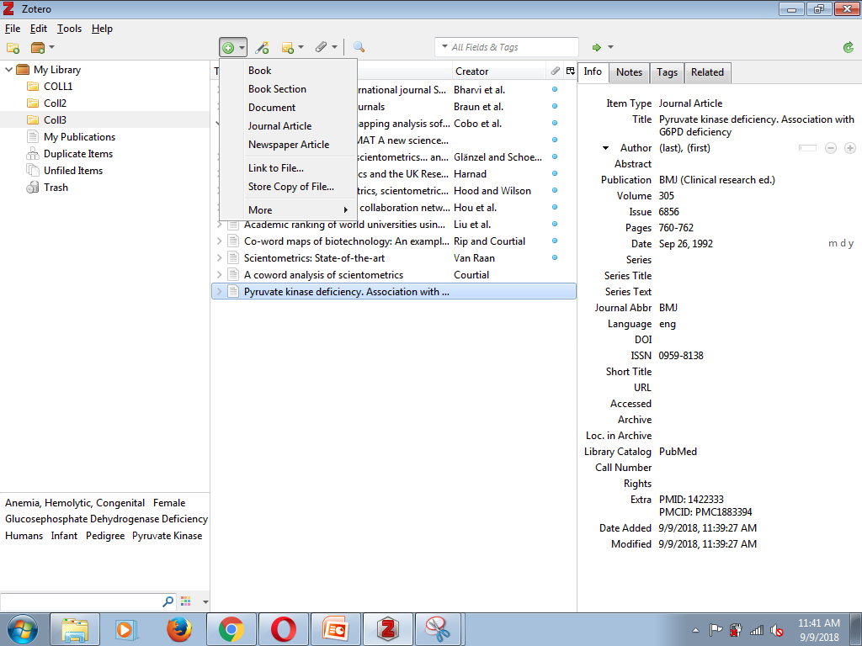
Click New item and fill the particulars of the documents.
#Putting references in library: d) Manual Entry
Click here

Slide 14
Click where you wants to insert citation in word>click zotero @ upper pan in word>add/edit citation,
#Inserting References in documents: a)Insert references
Click here

Slide 15
Insert keywords of reference you wants to add in box it will show related references in library>hit enter.

Slide 16
We can change styles of reference in document preferences menu as per our choice.
Click here

Slide 17
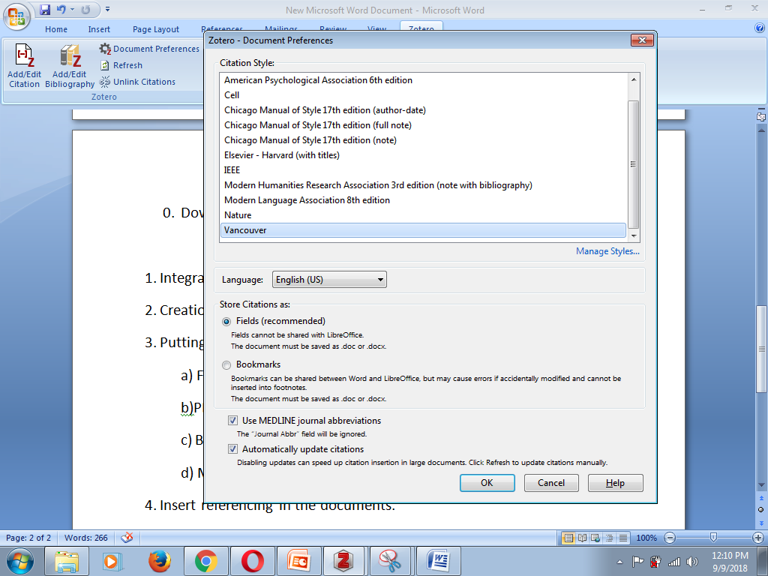
We can add and manage styles by clicking manage references
Click here

Slide 18
Next window>click get additional slides
Click here

Slide 19
New window will come up with Zotero style repository> double click preferred style and it will be added to directory.

Slide 20
Click where you have to add bibliography in word>Zotero>add/edit bibliography>bibliography will be added in prior specified style.
Click here
#Inserting References in documents: a)Insert bibliography

