Slide 1
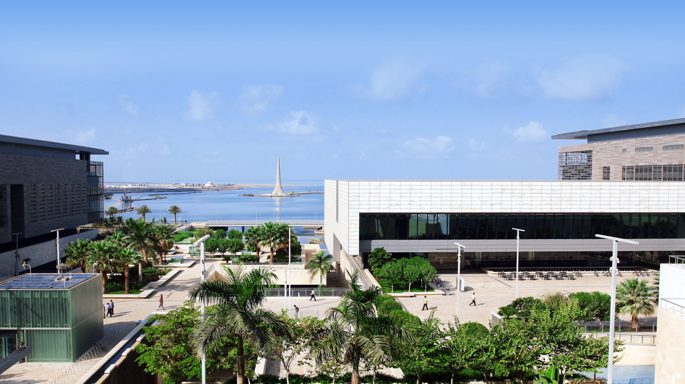
ePosters Replace Print Posters: KAUST Library Initiative to Better Prepare Students and Preserve Scholarly Resources
J. K. Vijayakumar
Garry Hall
Eman Afandi

Slide 2
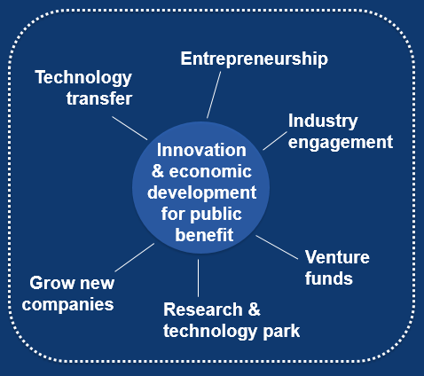
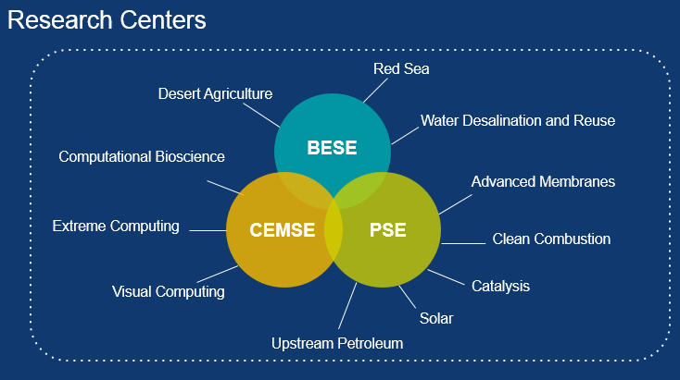

Slide 3
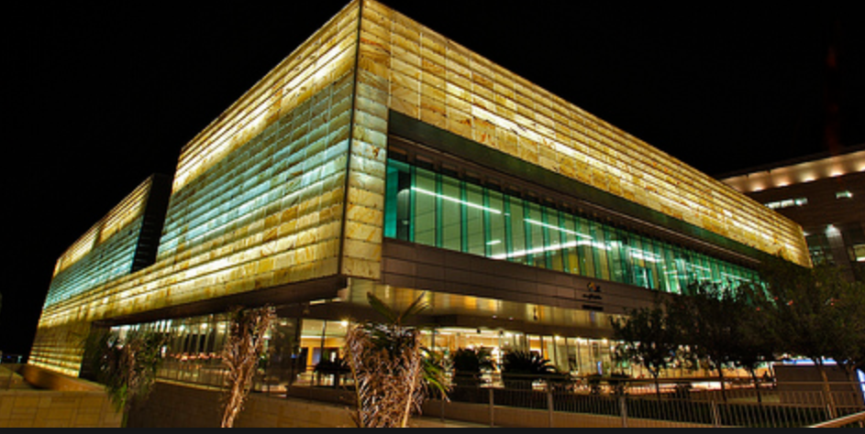
University Library
Born digital (98% of collection is online)
Open 24x7 with inspiring space and
highly specialized collection
First Open Access mandate in the Middle East
Best Library Architecture award from AIAA / ALA in 2011
Successful research repository supported by policies and tools
Direct relations and negotiations with publishers and vendors
Great involvement of staff in regional and international professional forums with focus on professional development
Highest level of community satisfaction and engagements

Slide 4
Library Service Role @ KAUST
Information Resources
Focused Collection
Preservation & Curation
Research Repository
Collaborative Space
Learning Space
Open Access
Quiet Areas
Academic & Social Events
Trainings & Liaison
Document Delivery
Records Management & Archives
Research Data Management
98% Collection in electronic
Technology
Notes:
Our services are categorized to three such as Information resources, where we build a focused collection relevant to our academic research community, provide them trainings on its better use and build other special services around our collection of e-journals, ebooks and databases. KAUST Library has the unique exception worldwide of having 98% digital collection. We are close to half million ebooks, but will not increase our print share above 8000.
Our preservation and curation services are established with mandate of University wide Open Access and Records Management policies. We are also attempting to collaborate with IT and research office to preserve research data produced at KAUST as the next step.
Space- the building is designed to support collaboration and open scientific dialogues in addition to learning and study. We provide space for scientific and community engagements, as well as technology and learning commons for the students, including scientific poster sessions.

Slide 5
KAUST Library ePoster service project back ground
We offer Space as a Service – Apx 12 scientific posters sessions are held in the library annually.
We provide Preservation and Curation – hard to get hold of posters after the sessions.
Many scientific organizations’ were moved to ePosters. There was a need to upskill our Students and prepare them for eposter creation and sessions.
In 2017 Library initiated discussions with stake holders and proposed ePoster project.
Trialed commercially available system with graduate students and post docs. A list of criteria was prepared, and asked companies to respond.
Shortlisted companies provided trials and webinar information. Visits to headquarters/conferences. Suitable system was selected and in parallel, and with KAUST IT support, suitable display touchscreens were sourced, along with display stands for the pilot projects (Jan 2018).
By mid 2018, after successful many pilots sessions and incorporating feedbacks, final service (KAUST Library ePoster Service) is approved.
WHY
HOW
Notes:
KAUST Library offer Space as a Service – scientific posters sessions are held in the library. We used to lend easels and provide printing services.
Prompted by observation that many professional organizations were moving to ePosters at their events and conference e.g. American Society of Anesthesiologists; RCOG (Royal College of Obstretics and Gynecology; ASRA (American Society of Regional Anesthesia). There was a need to upskill our Students and prepare them for eposter creation and sessions.
Initiated in 2017 at the KAUST Library, with trialing of a commercially available system, initially by graduate students.
Lack of a suitable system resulted in broader search for companies who were invited to respond to a list of criteria.
Shortlisted companies provided trials and webinar information, prior to visits to headquarters/conferences where their systems were in operation.
In parallel, and with KAUST IT support, suitable display touchscreens were sourced, along with display stands for the pilot projects (Jan 2018).

Slide 6
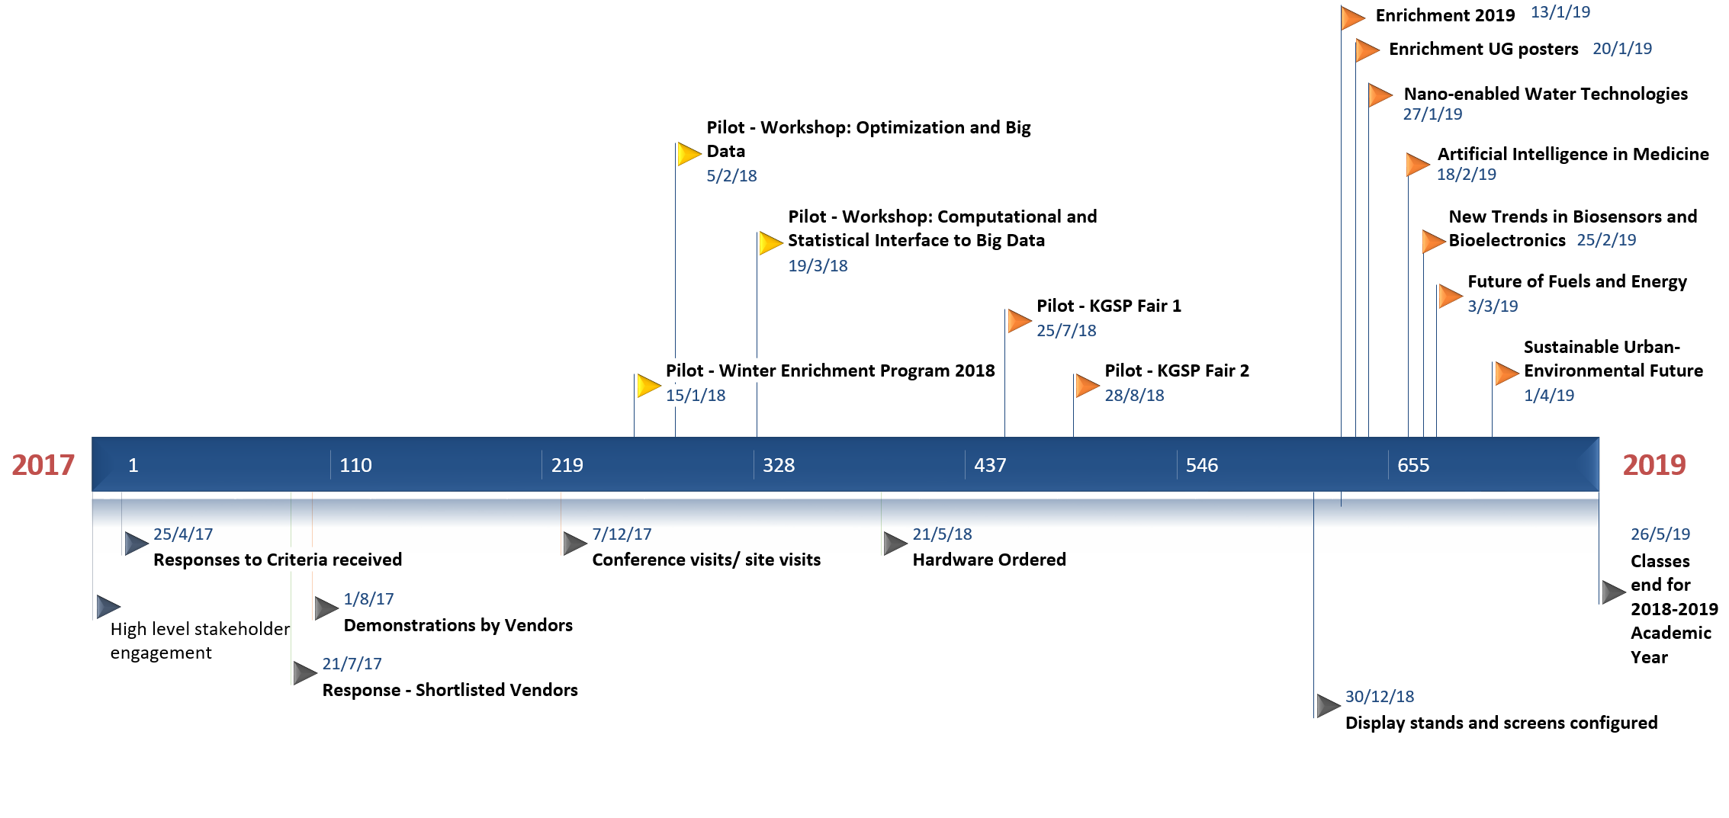
Timeline – KAUST Library ePoster Service

Slide 7
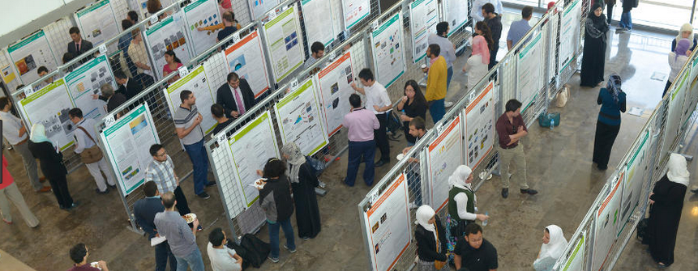
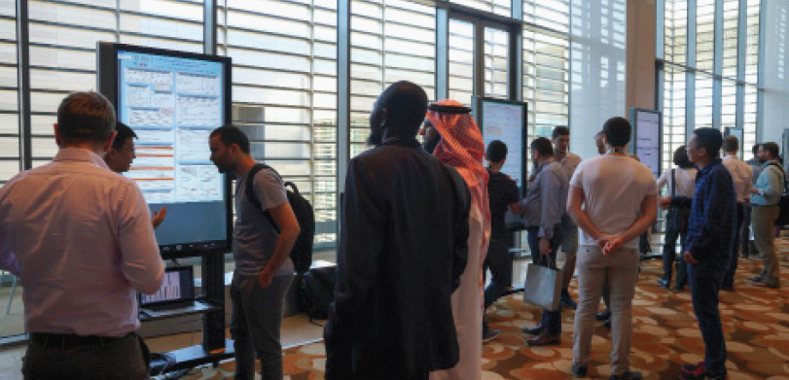
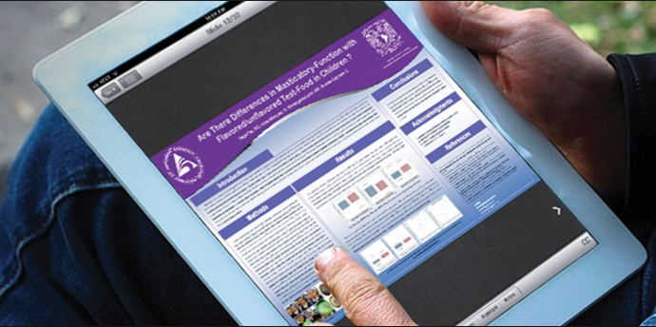
THE DIGITAL TRANSFORMATION in poster sessions
Notes:
In essence – we’re moving and upgrading a library service that we’ve always offered (grids) to an integrated digital service that captures intellectual content and preserves it, initially on a web site from which a feed takes it into our research repository. Along the way there are a host of benefits including it being available on any device such as the tablet shown

Slide 8
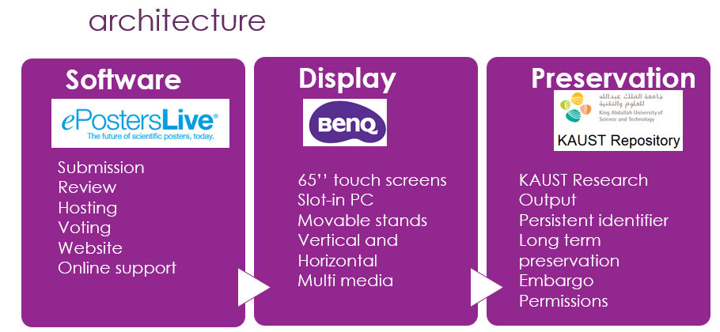
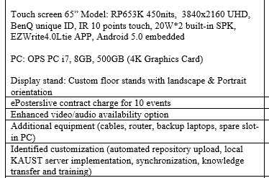
Library initiative to better prepare students and preserve scholarly resources

Slide 9
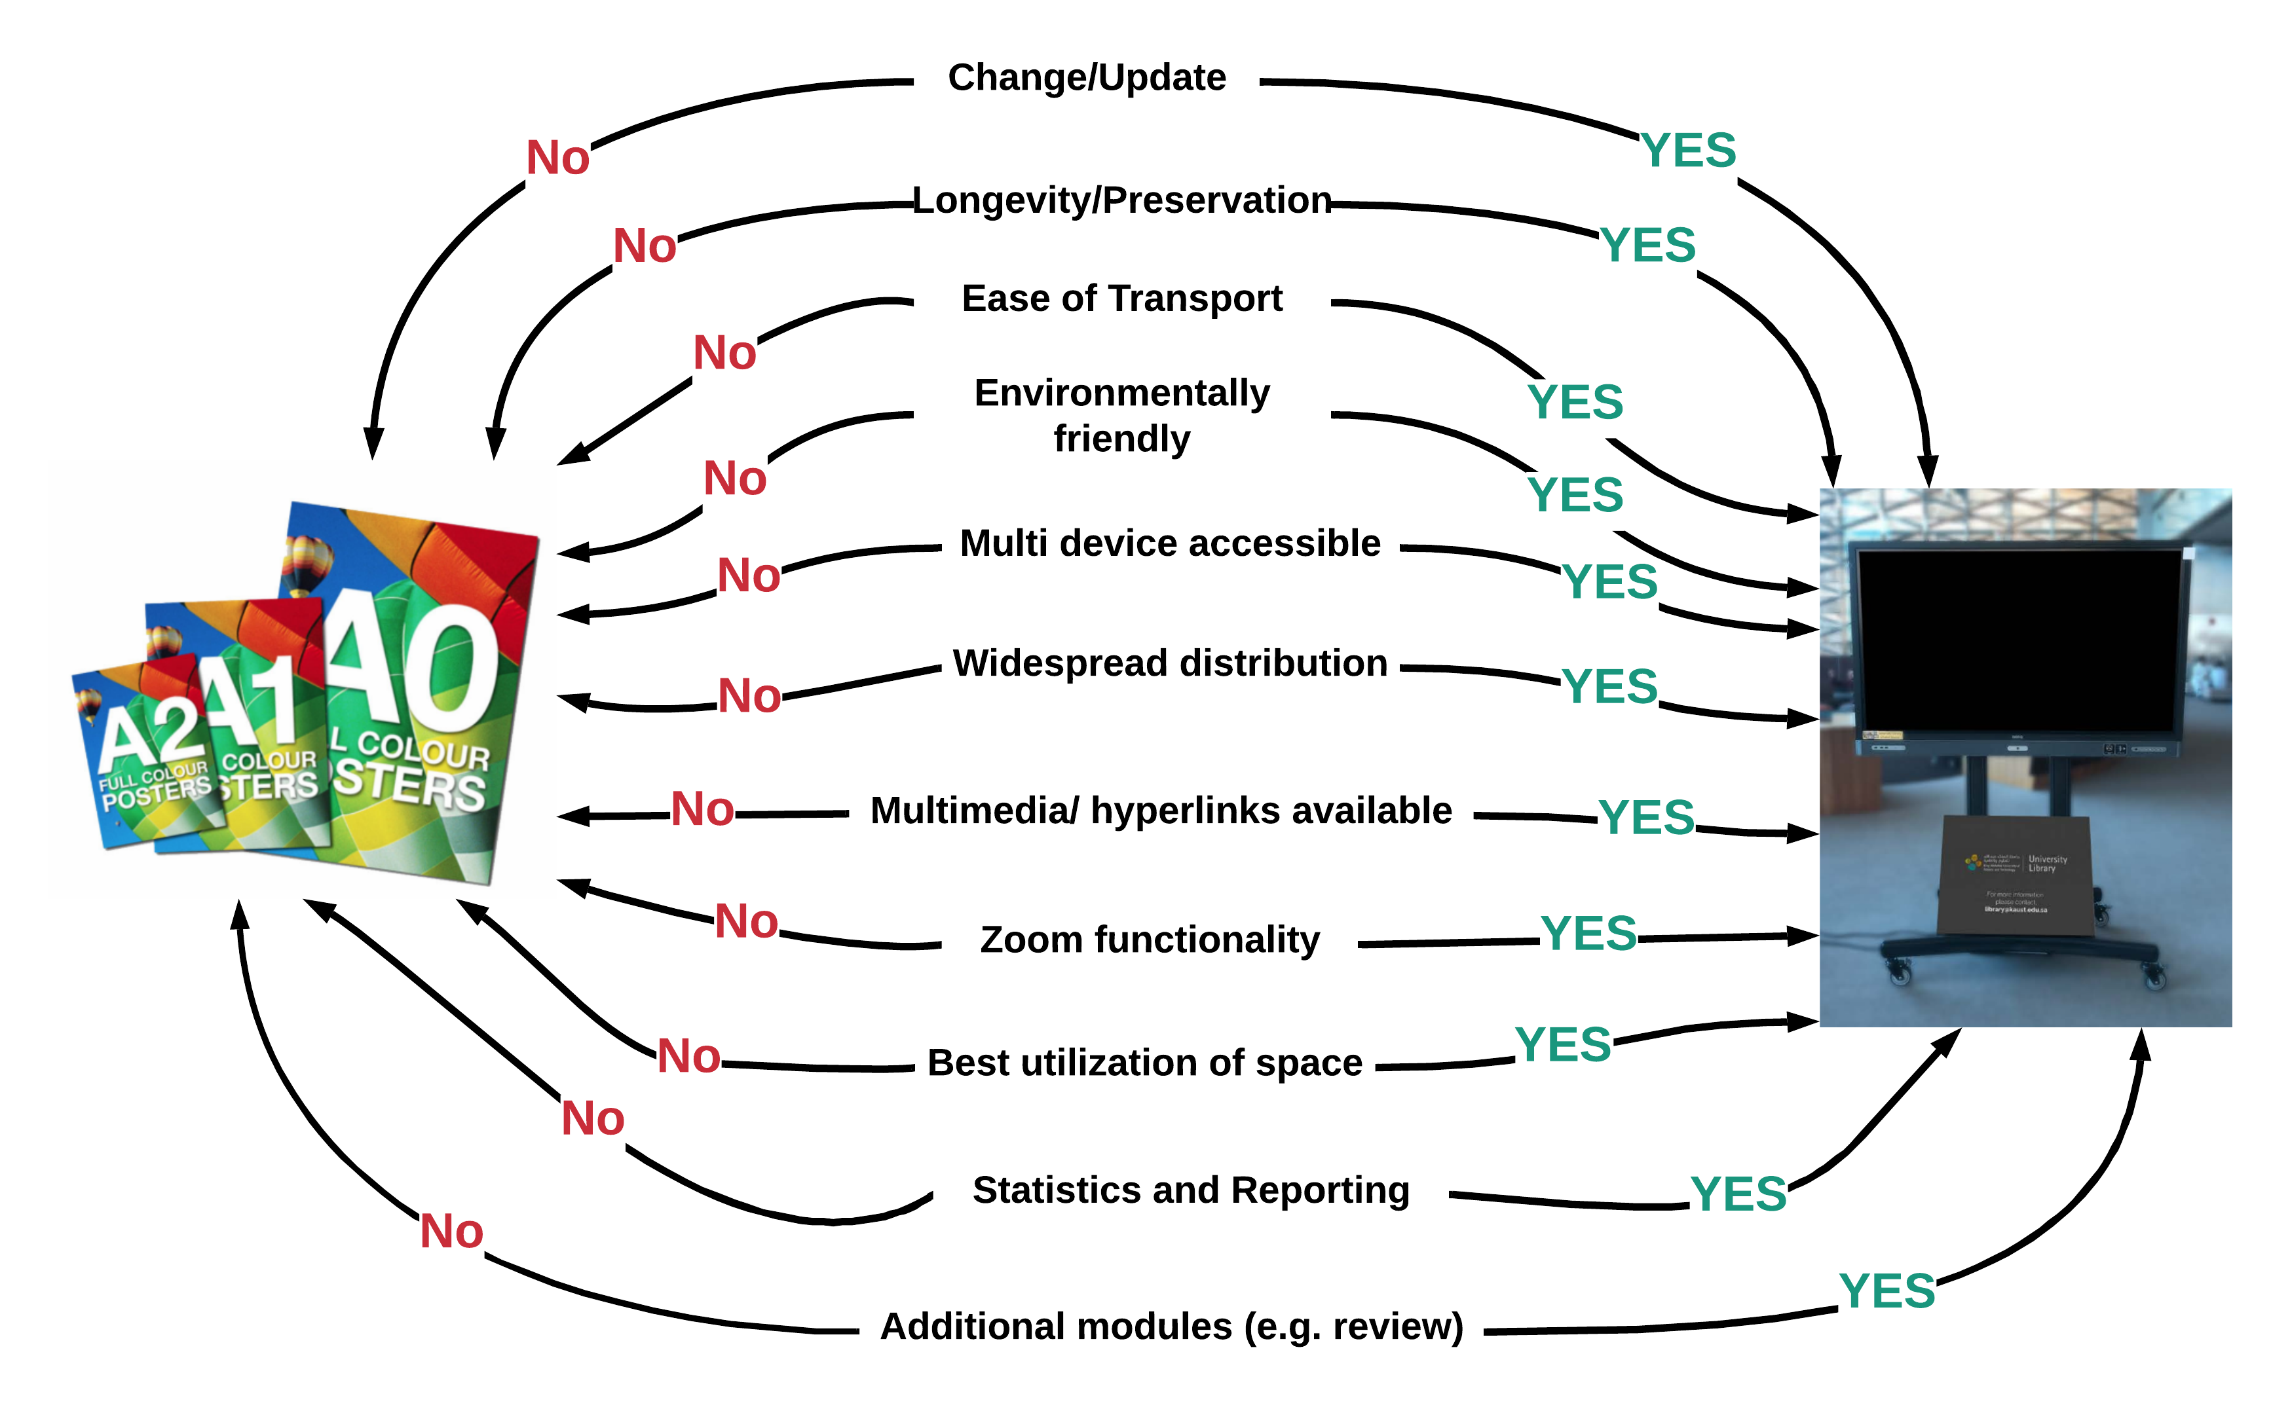
Advantages

Slide 10
Benficiaries
Feature | Student | Preservation Efforts | Other
Change/Update | X
Longevity/Preservation | X | X
Ease of Transport | X
Environmentally friendly |  |  | All
Multi device accessible | X |  | Participants
Widespread distribution | X | X
Multimedia/hyperlinks | X
Zoom functionality | X
Space Utilization |  |  | Organizer
Statistics and Reporting | X |  | Organizer/Library
Additional Modules |  |  | Organizer/Judges

Slide 11
Disadvantages/ Challenges
Initial setup is reasonably complex process, especially if you are in Saudi Arabia. For example, as backup we’re currently working on a virtual server to ensure local access if Internet outage occurs.
Cost; we chose touch screens but it is possible to use LED screens. These sacrifice zoom functionality and more closely resembles the situation with print but are much cheaper to implement.
Dealing with change management in academia!!!!
Notes:
Needed a concerted campaign of pilots, demonstrations and meetings to ensure uptake would justify the effort and expense

Slide 12
Website built for each event

Slide 13
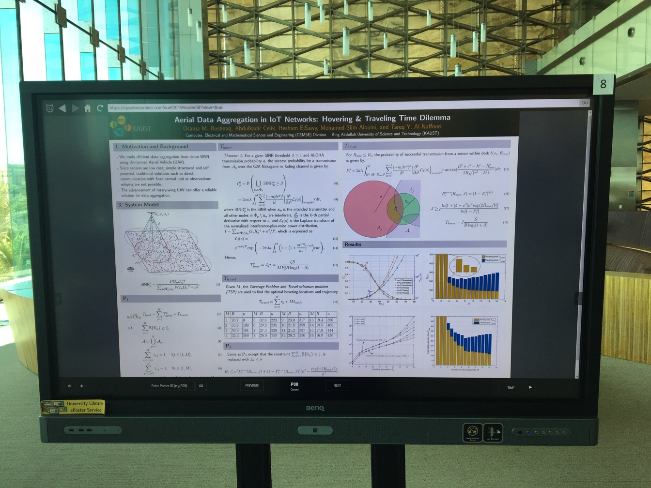
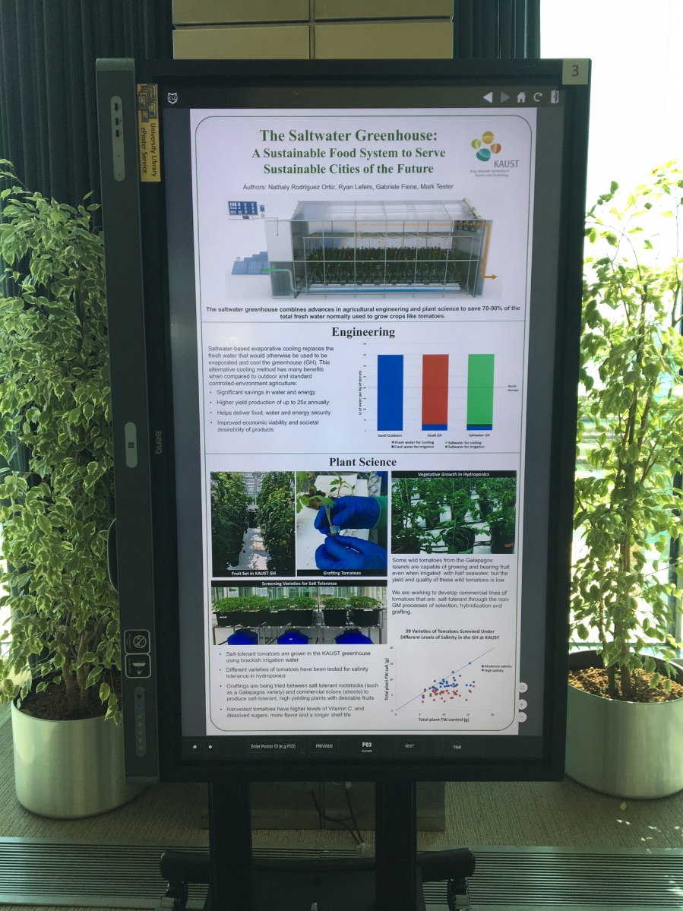

Slide 14
Critical Success Factors
65 inch screen is larger than A0 poster

Slide 15
Critical Success Factors
A0 size needs to be met or exceeded
4K display capability critical
Internet reliability and back up options (i.e. virtual server)
Committed and responsive vendor – ePosterslive
Address local requirements – “split screen” development
Notes:
Complications – different time zones and weekends (but eposterslive was already experienced with timezone differences given US market)

Slide 18
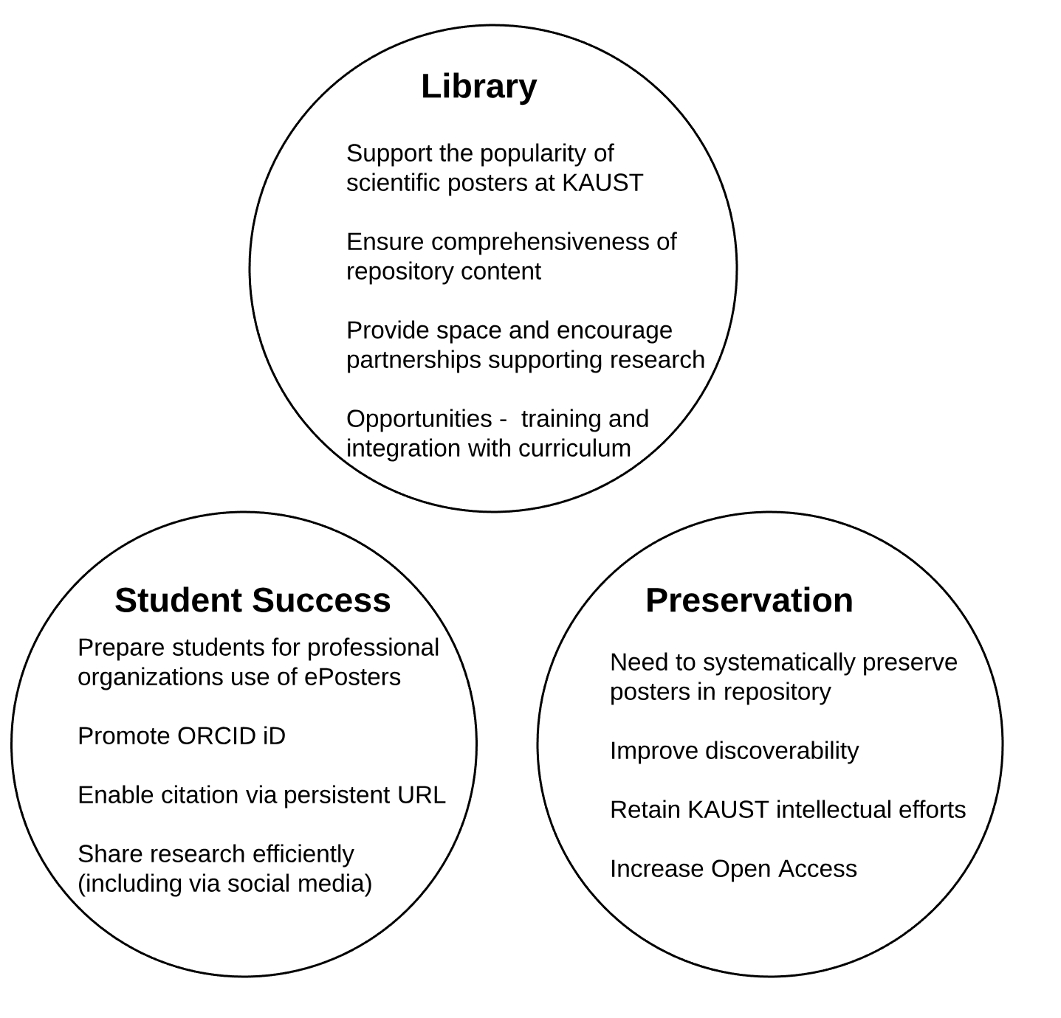
IMPACT
Notes:
IMPACT
Space utilization – use of library space; partnership. Scholarly communication focus rather than technology

Slide 19
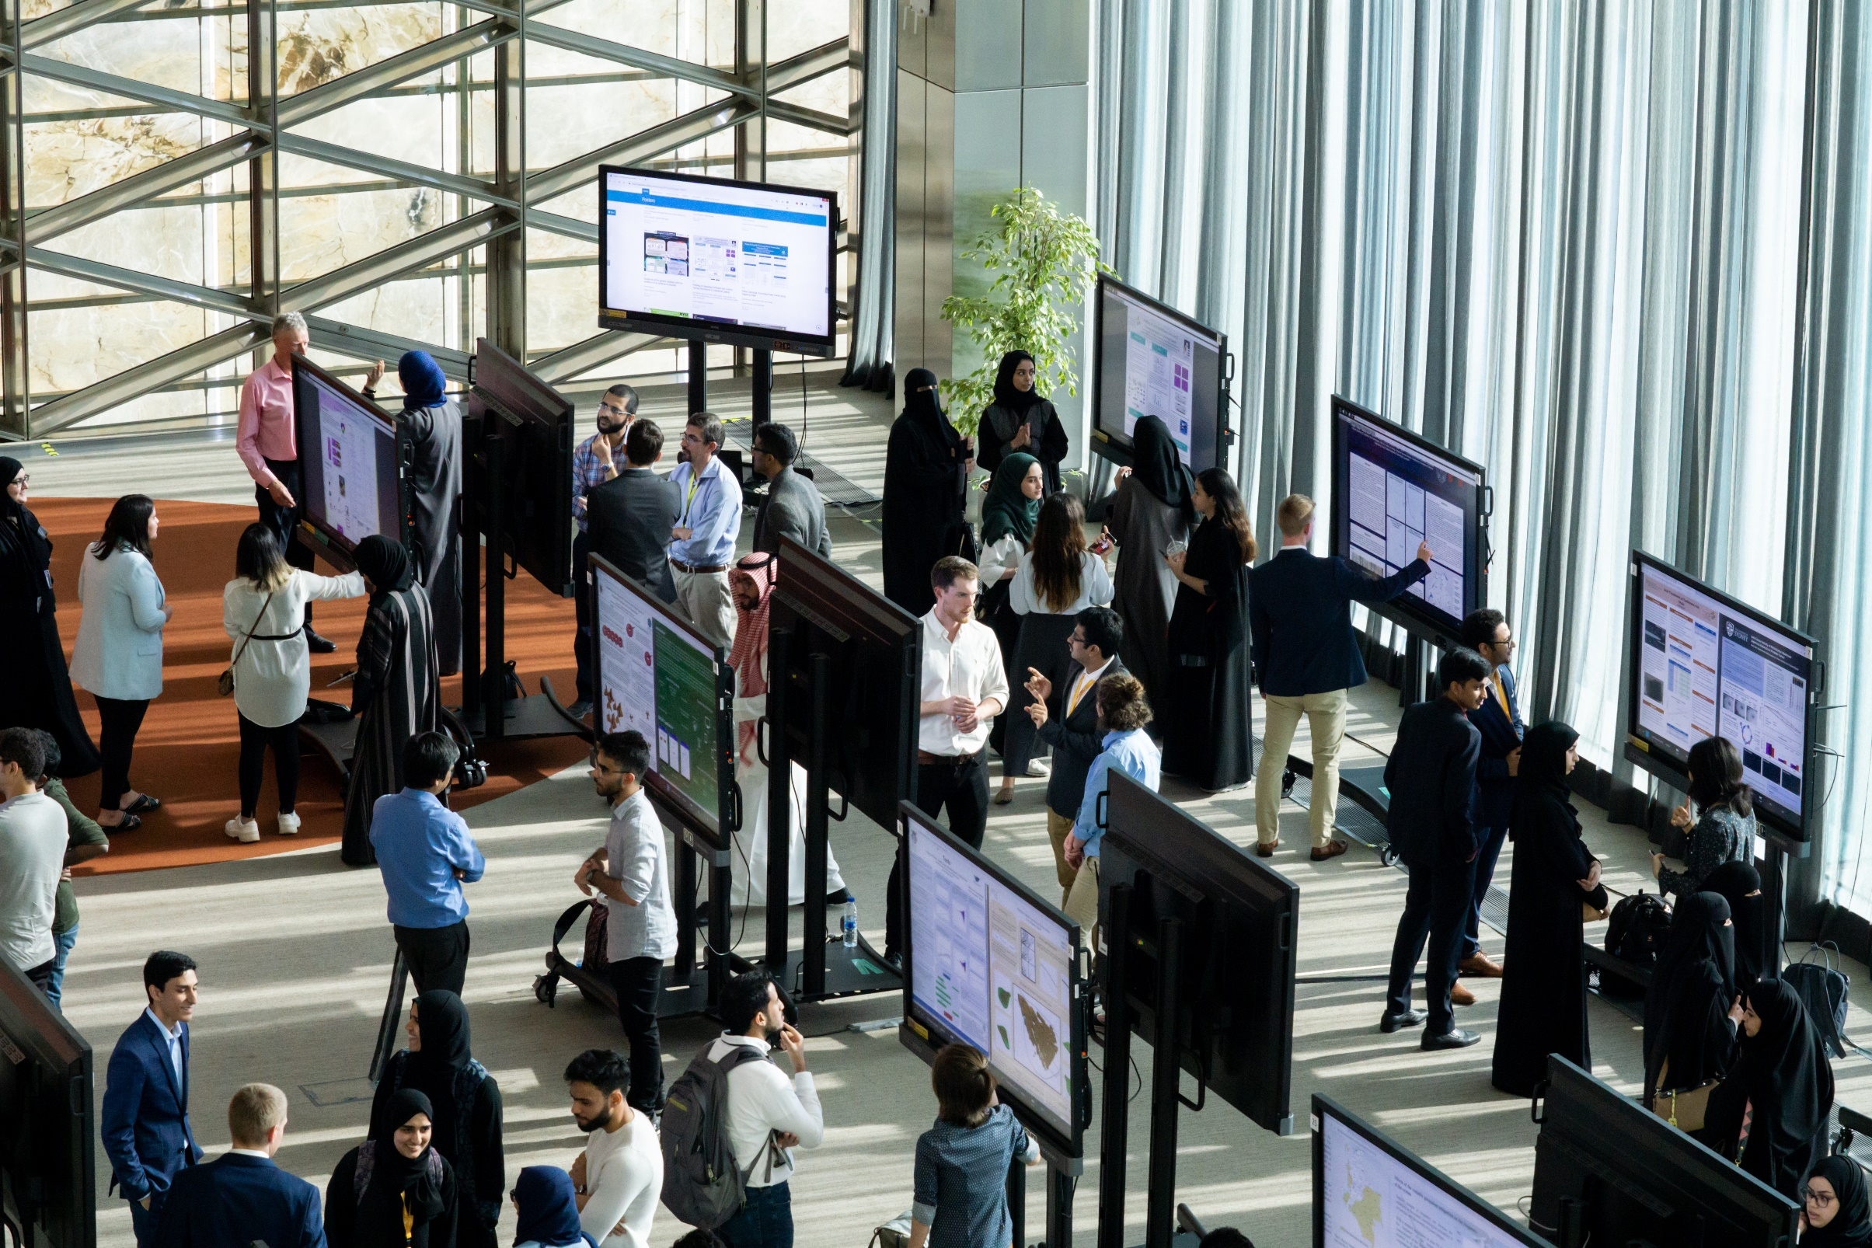

Slide 20
Reactions
"To be candid, we are thrilled with the opportunity to use the E-poster system. The technology is one thing. The web archive is perhaps even more significant for the mainly young or remote authors at our meeting. Posters are not "second place" entries here. One could even argue that they have a better archival life and better production value than the talks."
David Keyes Director Extreme Computing Research Center, AAAS Fellow
Senior Associate to the President
“This collaboration will be ongoing in alignment with KAUST’s Library’s goals in relation to the evolution of the scholarly record and “patrons as creators”. Our partnership represents an excellent use of both physical and human resources at KAUST, enhancing the professional development of KAUST students who are fortunate to have this tremendous resource available to them”.
Kathleen M. Emmenecker
Manager for English Programs
Notes:
David – excited by preservation of intellectual content
Kathy – focused on the student preparation – patron as creator element.

Slide 21
Lessons Learned
Convenience over Quality – solved by making ePosters convenient!
Investment in touchscreens is worth it – old screens are used as digital signage
Vendor commitment and responsiveness is paramount
The service expands library involvement beyond the building
Good internal IT support is required
Involve stakeholders! From as early as possible (e.g. student assessment of various systems in order to get shortlist)
Look at what is already done – portrait/landscape was a potentially big issue, with A0 portrait the default; changing this has been a challenge.
Notes:
Classroom and Collaboration unit have prioritized supporting Library in delivering this service

Slide 22
Lessons Learned
Change is hard in academia – be prepared for this. We commissioned ‘split screens’ to create a “1-1” experience analogous to printed posters where the number of presenters exceeded our number of screens.
As service providers, the Library has to adapt rather than expect the organizers or users to do so.
Go Big (A0 equivalent was the KAUST standard, so 65” was required to meet user expectations; 55” wasn’t acceptable).
Go High Quality (4K) to compete with quality of printed equivalent.
Need ‘lock down’ software (Kioware) to avoid users playing with the screens!
If possible, do not introduce charges until the service has been accepted.
Have your own supply of spare parts in order to deal with hardware outages, display stand wheels, power boards etc. This is particularly important when you are at the limit of your available screens.

Slide 23
Lessons Learned
Screen rental could be an option in large cities.
Its been challenging getting sufficient notice to utilize the system fully. Hopefully as awareness increases and understanding of the efficiencies gained, we will have more fully optimized events.
Work with stakeholders who are supportive of the approach e.g. at KAUST we work with our Office of Sponsored Research, who also offered funding should this have been required.
Encouraging participants to use high resolution images can have repercussion for file size, which directly affects the time taken to load a poster.
Unwillingness to trial alternative models in use at many international conferences e.g. multiple posters on one ‘themed’ screen.
Notes:
File size – one file was over 150 MB. Using smallpdf.com we reduced it to about 3MB

Slide 24
Challenges and the Future
Embarking on this or similar projects; a major challenge is managing change in academia.
Enhancements available (e.g. password access) and need to be managed and implemented.
Market and promote relevant eposter modules or apps e.g. review, reporting/ voting
Remain focused and responsive to user requests (e.g. split screen)
Seek opportunities linked to student success (e.g. 3D scanning).
Notes:
Built in android – functionality available but can cause minor issues when writing functionality suddenly appears
Enhancements envisaged – Dashboard, Password protection currently exists for site – individual poster; increased ‘smartboard’ interaction
Remain focused and responsive to user requests
Opportunities for student success- Jupyter notebooks, 3D scans, Three Minute Thesis Format, touchscreen functionality….
Encouraging use of other eposter modules/apps e.g. review, reporting/ voting

Slide 25
Challenges and the Future
Administrative change needed from organizers e.g. better planning, reducing the ‘just in time’ approach.
Optimize engagement dynamics through different models e.g. themed screens.
Technological advances to improve results and/or manage costs
Managing service issues – extended hours for staff, spare parts, expanding skill set to support the technology and events.
Promote content through Open Access.
Notes:
Technological advances to improve results and/or manage costs e.g. monitoring touchscreen glass
turn any standard piece of glass into an interactive touch screen

Slide 26
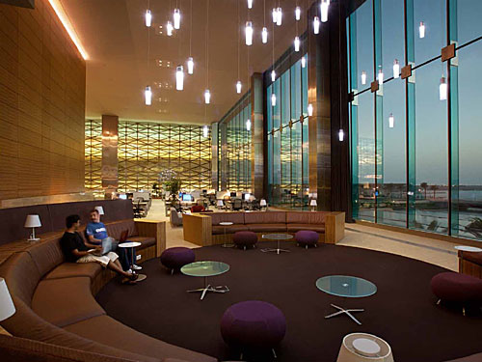
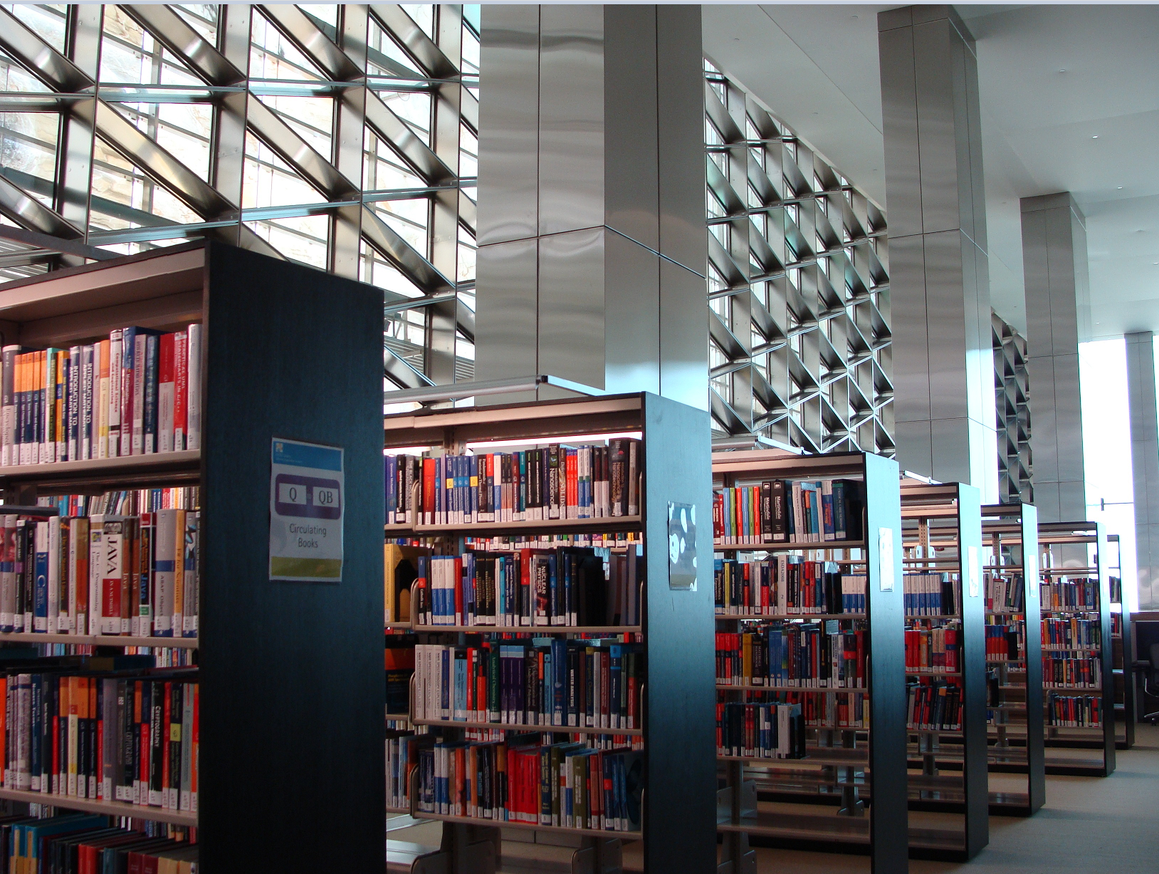
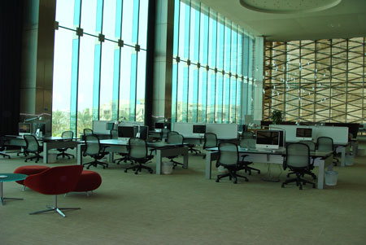
Thank you

