Slide 1
Exploring off-set pricing models and article deposit terms at King Abdullah University of Science & Technology (KAUST)
The Upside Down

Slide 2
KAUST

Slide 3
International graduate research university dedicated to advancing science and technology through:
interdisciplinary research
education
innovation
KAUST seeks to advance scientific research and collaboration, transcending disciplines and boundaries for the benefit of science.

Slide 4
Research addresses challenges of global significance, in the areas of water, food, energy and the environment.
KAUST is committed to:
the highest standards of research and academic excellence
attracting and developing top global talents based on merit
fostering a spirit of enterprise encompassing innovation and opportunity to catalyze the economic development of Saudi Arabia

Slide 5
March 2017

Slide 8
KAUST faculty - highly cited 2017
Mohamed Eddaoudi Chemistry
Iain McCulloch Chemistry/Materials Science
Magnus Rueping Chemistry
S Mani Sarathy Engineering
Carlos M Duarte Environment/Ecology
Jean MJ Frechet Materials Science
Hiroaki Fujii Plant & Animal Science

Slide 9
The pricing of library resources
Normal pricing
Library journal pricing

Slide 10
Offset Pricing
The Upside Down

Slide 11
Defining the Problem
University provides context Space, utilities, resources, equipment, technologies, information Funding agencies provide funds Researchers provide ideas and skills Raw data, reports, processed data Publishers provide access Editorial services, indexing, abstracting, metadata, marketing
Are all these entities non-profit?

Slide 12
Open Access Types
Green access funded by the university
It’s Green because it costs you more KAUST repository
peer reviewed articles 6253?
Gold Access funded by
Articles Processing Charges (APCs)
Other means
How important are these terms?
More important to understand your options with publishers and your negotiating strengths
What did it cost to produce these articles?
How much are we paying to get them back?

Slide 13
Principles of offsetting systems (JISC 2015)
Systems should operate in the context of a transition to fully gold open access and
support that transition. To meet this principle, a system should be inclusive, remove
barriers (both to authors and their institutions) to open access and ensure that all the
outputs of a sub scribing institution are immediately open on publication under licenses and other conditions which meet funders’ mandates and other requirements. These systems will be designed to enable the publisher’s journals to become fully open access as soon a tipping point is reached
Offset systems should also apply, at the level of each subscribing institution, to ensure that the cost incurred by each institution for scholarly publishing is contained. Publishers should also apply global reductions to the cost of subscription in respect of increasing volumes of open access articles in hybrid journals in line with their stated “No Double Dipping Policies”.

Slide 14
More principles of offsetting systems (JISC 2015)
Systems should ensure that publishers do not charge the same institutions
twice, through the payment of subscriptions and the payment of APCs
Offset systems should not be restricted to institutions that subscribe to large collections of journals (the big deal) but should also apply to all institutions that subscribe to individual journals with a hybrid OA offering from a publisher.

Slide 15
Even more principles of offsetting systems (JISC 2015)
Systems should operate on a “cash basis” and avoid the additional administration
and work involved in handling vouchers, particularly if those vouchers have an expiry
date. Where an offset system does operate on the basis of vouchers, they must be
available to the institution (which processes the transactions) rather than to individual
authors.

Slide 16
Some APC models
At the start of 2017 Jisc Collections had offsetting agreements in place with the following publishers:
· De Gruyter: hybrid APCs for articles published in one year are offset against institutions’ expenditure on subscription and licence fees in the following year
· IOP (Institute of Physics) Publishing: hybrid APCs for articles published in one year are offset against institutions’ expenditure on subscription and licence fees in the following year
· SAGE Publishing (including the Royal Society of Medicine and the Institution of Mechanical Engineers): discount on APCs in hybrid titles, requires a code
· Springer: ‘flipped’ model, where UK subscription spend has created a ‘publishing pot’ to fund APCs. An additional transition fee covers access to subscribed content
· Taylor & Francis: institutions receive vouchers which offer a significant discount on APCs. The number of vouchers is based on expenditure
· Georg Thieme Verlag: complimentary APCs are included with subscription agreement
· Wiley: institutions are eligible for a tiered credit based on overall level of expenditure. The credit is added to an institutional account, which is drawn down against APCs.

Slide 17
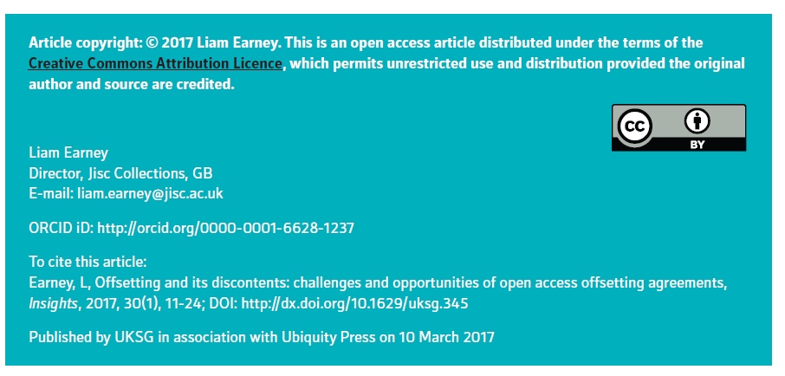
Rising prices
If an OA model is meant to replace the subscription model, why does expenditure on both APCs and subscriptions continue to rise so inexorably? It does not matter that many of the offsetting agreements are pilots and have not yet been fully reviewed. The fact that the expenditure lines are not flat or falling in either case makes offsetting agreements resemble nothing more than an ‘advantageous lock-in for status quo publishers’.19

Slide 18
How do we get the OA terms we want into our license agreements?
Head
Me
Brick wall

Slide 19
How do we get the OA terms we want into our license agreements?
Long drawn out difficult process
Long term vision necessary
Can take years – literally
No guarantee of ever reaching conclusion
Ambiguity
Frustration for staff involved
Publishers quite content to have OA and T&DM guidelines on their websites. These can be changed overnight
Publishers reluctant to shorten embargo periods
Publishers need to be convinced that their bottom line will not suffer
We need evidence to support our viewpoint. The OA for ‘a better world’ argument will not do.

Slide 20
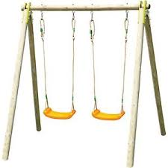
Article Processing Charges (APCs)?
The author/university/corporation/institution pays a charge per article (gold open access) for the author to publish in a gold open access journal

Slide 21
Extra Costs of Open Access
A UK study of the costs of full-scale implementation of OA publishing to comply with the British mandate concludes that institutions’ management of one single OA publication takes two hours and incurs administration costs of £81.2
Counting the Costs of Open Access: http://www.researchconsulting.co.uk/wp-content/uploads/2014/11/Research-Consulting-Counting-the-Costs-of-OA-Final.pdf (accessed 18 March 2015).

Slide 22
Offset Pricing
Complex models where APCs are taken off (off-set) against the total subscription charges

Slide 23
Consequences of no offsetting
Elsevier, the one major publisher with no offset deal in place, has seen high growth. There is currently no penalty for publishers who reject offsetting deals
No penalty!
Profits

Slide 30
Different models of offset pricing American Chemical Society ACS Royal Society of Chemistry RSC Springer National/Disciplinary Offset Models Institute of Physics IOP

Slide 32
Offset Models – Royal Society of Chemistry (RSC)
Voucher codes to make papers available via OA free of charge
Number of vouchers calculated by dividing the subscription the RSC receives from an institution by 1,600 GBP (the APC of the RSC)

Slide 33
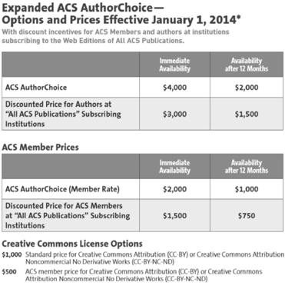
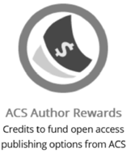
Offset Models – American Chemical Society (ACS)
Credits to fund OA publishing options from ACS

Slide 34
An Institutional Model?
MIT-Springer Author Rights Agreement
Allows MIT authors to post an author’s or author’s departmental web pages and after 9 months, may be archived and/or deposited in any repository for noncommercial purposes
Applicable to articles published in a Springer journal subscribed (2009-2017)

Slide 35
KAUST and (the Open Access workflow)

Slide 36
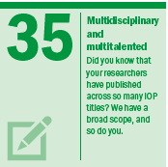
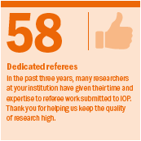
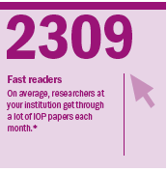
IOP Facts and Figures

Slide 37
The Model
The move towards open access by some institutions or countries in advance of other institutions or countries increases costs to those ‘early adopters’, because they pay for free access to their research for the rest of the world while still paying for access to the rest of the world’s research.

Slide 38
The Model
This model ensures a balance between:
local offsetting (against an institution’s subscription and licence fees)
global offsetting (global reductions in subscription and licence fees).
As the proportion of hybrid articles grows the balance moves on a sliding scale from 90% local and 10% global to 10% local and 90% global. The model takes income from hybrid APCs and allocates it in these proportions to reduce local and global costs.
Why? As the proportion of hybrid open access articles grows in a journal or collection of journals, customers which do not themselves support gold open access will still demand reductions in subscription and licence fees in respect of open access content.

Slide 39
The Model At low level of OA publication most of the cost is offset locally to the universities At high level of OA publication the balance moves towards greater global price reductions in prices.

Slide 40
Proportion of articles in all relevant subscription journals published on an open access basis with payment of an APC | Proportion of hybrid open access income offset locally against subscription and licence costs of those paying hybrid APCs | Proportion of hybrid open access income offset globally through discounts on subscription and licence fees
0% | 0% | 0%
1-4% | 90% | 10%
5-9% | 80% | 20%
10-14% | 70% | 30%
15-19% | 60% | 40%
20-24% | 50% | 50%
25-29% | 40% | 60%
30-34% | 30% | 70%
35-39% | 20% | 80%
40%+ | 10% | 90%

Slide 41
IOP Publishing offsetting and library-funded APCs
IOP offer an hybrid open access publishing option on the majority of their subscription titles as well as three Gold open access journals.
There are options to help institutions support their authors on the cost of open access, while recognising the additional spend on top of their license fee.
IOP identifies articles for institution validation for funding, and offset funds spent on hybrid open access with the institution’s license fee.

Slide 42
Offset Support
IOP rebate a portion of the hybrid APCs spent with IOP over the previous year, up to the value of the institution’s license fee.
The percentage rebate applied depends on the proportion of open access articles in our subscription titles, as IOP offset a portion locally (directly to the institution).
The remainder is offset globally (via a reduction to all customers).
This ensures a fair process and guarantees that no one is paying twice for IOP content. In recent years the local rebate has been 90% of charges paid, with the remaining 10% going towards a worldwide cost reduction.

Slide 43
This should avoid ‘double dipping’ paying the subscription paying the APC

Slide 44
KAUST workflow for Open Access
Articles from KAUST authors are automatically identified for this arrangement based on the corresponding (submitting) authors’ email domain. The authors are notified of possible OA funding.
Once an article is accepted, a validation email is sent to KAUST to confirm inclusion in the arrangement. This includes an attached PDF of the article.
KAUST confirm / deny funding for the article by email within 3 working days. If no response, the article will revert to non-OA.
If KAUST approve funding, the article is made open access and published, with the charge applied to KAUST’s institutional OA account.
Every quarter, IOP invoices KAUST for the relevant amount and includes a list of published articles.
At the end of the year, Offset calculations will be done based on the qualifying number of open access articles published.

Slide 46
What IOP needs from us
Confirm email domain(s) and institution(s) that qualify for funding.
Confirm contact address for validation emails, and ability to respond within 3 working days.
Pay quarterly invoices as appropriate.
Provide any additional information for our Open Access web pages.

Slide 47
New Licence Terms: Wild west
In our experience:
Offset agreements usually not disclosed
Increased Competition should reduce costs
No individual institution models yet
We started negotiating with others to have an institutional level off-set model agreed and signed via subscription licences
The RSC gold-for-gold model

Slide 48
ESAC Intact (transparent infrastructure for article charges)aims at establishing transparent and efficient procedures to manage APCs for OA publications
Joint understanding of offsetting (March 2016)
Offset deals are pilot models (in transition)and should therefore lead to a proper OA model (agreement between publishers and institutions)
Opportunity to overcome DYSFUNCTIONALITIES experiences in the current subscription system and to improve the business of scholarly publishing
Need mechanisms for offsetting agreements, reduce workloads etc.
Tools and infrastructure should be in place

Slide 49
ESAC Intact (transparent infrastructure for article charges)aims at establishing transparent and efficient procedures to manage APCs for OA publications
Joint understanding of offsetting (March 2016)
Offset deals are pilot models (in transition)and should therefore lead to a proper OA model (agreement between publishers and institutions)
Opportunity to overcome DYSFUNCTIONALITIES experiences in the current subscription system and to improve the business of scholarly publishing
Need mechanisms for offsetting agreements, reduce workloads etc.
Tools and infrastructure should be in place

Slide 50
Joint COAR-UNESCO Statement on OA
There is no “one size fits all” solution to implementing OA
Consider developing countries
Consider institutions with small budgets
Avoid large scale monopoly and concentration on the international publishing industry
Encourage non-APC based journals that support OA and enhance the repositories with innovative systems

Slide 51
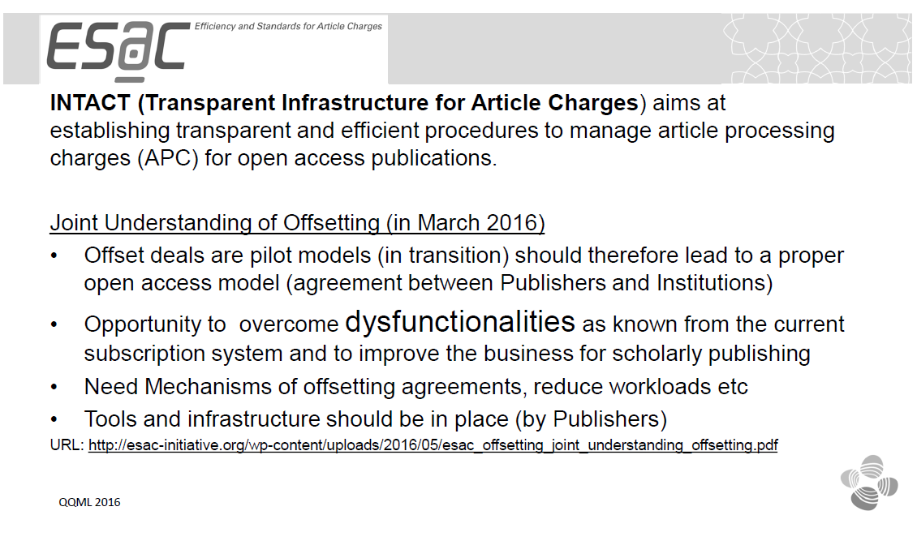

Slide 53
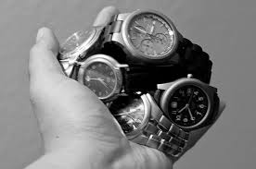
Why is this important?
For librarians – it will save:
money
time
stress

Slide 54
Why is this important?
For faculty/researchers –
it will save:
time
anxiety
stress

Slide 55
Why is this important?
For our Institutional Repository it will bring
clarity
transparency

Slide 56
Where to publish?
The university library cannot and should not tell researchers where to publish.
We are promoting this pilot model by IOP to offset the costs of hybrid open access publishing.

Slide 57
The Future of Off Set Pricing
It will not exist
Nobody will remember what it is
It will only be bad dream
This will be a good thing

Slide 58
Article Deposit Terms
KAUST University Library is contacting all its vendors/publishers as we attempt, through a process started last year, to standardize processes in relation to Open Access (OA), Article Processing Charges (APCs) and Text and Data Mining (TDM). Please can you fill in the fields below where relevant/possible?
Open Access:
Following on from last year’s discussions we would like to propose the text below (relating to Green Open Access) for inclusion in all future licensing agreements.
The subscriber (KAUST) has adopted an open access policy pursuant to which its affiliated researchers, faculty, students and staff grant to the University a non-exclusive permission to make available their scholarly research articles for the purpose of open dissemination. In connection therewith, and with publisher name and the partner publishers’ committed support towards Green Open Access, the parties hereby agree that final versions of articles authored by KAUST affiliated researchers, faculty, students and staff can be deposited in KAUST research repository immediately after acceptance of the work (or 6 months after publication).
We do not believe that the inclusion of the above will compromise publisher name or place it at any commercial disadvantage. Please can you:
a/ indicate acceptance of wording above for inclusion in future license agreements.
b/ propose alternative wording for inclusion on future license agreements
c/ offer alternative proposal

Slide 59
Article Deposit Terms
Article Processing Charges:
Do you have a system of APCs? Yes or No. If Yes please can you provide an explanation of:
a/ how your system works
b/ specifically what workflows are involved for the library?
Text and Data Mining:
Finally, we are attempting to clarify various publisher policies on TDM and specifically whether these polices can be included in forthcoming license agreements. Please can you let me know:
Do you have TDM policies? Yes or No. If Yes
a/ what they are?
b/ are they included in your license agreements?
c/ are they included in your policies online or elsewhere?
The information above is of great importance to KAUST University Library as we attempt to provide accurate, clear and concise information to our research community around issues of Scholarly Communication.

Slide 60
OA2020 Transformation A growing number of research organizations want to establish an international initiative which aims to convert the majority of today’s scholarly journals from subscription to Open Access (OA) publishing. This is the result of the 12th Berlin Open Access Conference hosted by the Max Planck Society (Dec. 2015.) An Expression of Interest invites all parties involved in scholarly publishing to collaborate on a swift and efficient transition for the benefit of scholarship and society at large. By cooperating at international level we can affect change

Slide 61
OA2020 Transformation- Risk

Slide 62
Alchemy
All offset models are works in progress. Let us turn the subscription money into publishing money

Slide 63
Map your position Policies, Infrastructure, Procedures, Stakeholders
Where are decisions regarding distribution of funds that cover subscriptions made and what steps are necessary to reorganize their flow?
Are you part of a consortium that can coordinate and streamline processes and negotiations for maximum impact?
Does your library have an acquisitions strategy that that aims to leverage opportunities for open access?
Does your institution have an Open Access Policy that supports the transition of scholarly communications to Open Access?
What channels can be used to achieve consensus with faculty and administration?
What steps, resources and authorizations are necessary to re-organize library support of new OA workflows.

Slide 64
Analyze and Assess your leveraging power Financial and Publication Data
Gather data on the publishing trends of your institution’s researchers: - Publisher and journal distribution, - Share of Open Access publication vs paywalled publication, - Share of corresponding authorship.
Gather data on the financial transactions behind your researchers’ OA publications and your subscription expenditures at the publisher and, if possible, journal level.
Analyze and compare your subscription costs with OA publication costs.
Establish more robust criteria for assessing the value of your current subscriptions by incorporating citation data (ie what journals are your researchers citing in their own publications), publication data (in which journals do your researchers publish) into COUNTER JR5 reports and other criteria relevant to your institution.
Gain an understanding of how much of the content currently subscribed is available open access through alternative sources.
Build a business case to support your transformation plan (divesting of subscriptions and investing in open access) based on the evidence gathered in your analysis and assessment exercises.

Slide 65
Fog of Data
Web of Science
Scopus
Repository
Others

Slide 66
Uncovering the relevance of OA in KAUST
Number of articles published in a given year:
which publisher?
which journals?
behind paywall?
in OA (hybrid journals)?
in fully OA journal?
How much is being paid in APCs for OA publication with a given publisher?
How much is being spent on subscriptions?

Slide 67
How to find the necessary information
Search WOS:
paste in Advanced Search Box:
OG=(King Abdullah University of Science & Technology) or OO=(King Abdullah University of Science & Technology OR King Abdullah University of Science and Technology OR KAUST OR king abdullah univ sci technol OR king abdullah univ sci & technol OR 4700 KING ABDULLAH UNIV SCI TECHNOL OR 4700 KING ABDULLAH UNIV SCI TECHNOL KAUST OR KAUST) OR AD=(Thuwal OR KAUST)
For publisher, journals, use Analyze Results.
For OA, use the filters on the left
Search Scopus:
Use affiliation search.
For publisher, journals, use Analyze search results.
For OA, use the filters on the left

Slide 68
From our Institutional Repository
The answers to:
which publisher?
which journals?
can be partially seen in the repository search results.
For example, if we look at the advanced search facets in the research articles collection and select a year like 2017
http://repository.kaust.edu.sa/kaust/handle/10754/324603/simple-search?query=&resource_type=2&filter_field_0=year&filter_type_0=equals&filter_value_0=2017)

Slide 69
We see the following:
Top five publishers: Elsevier BV (341) Wiley-Blackwell (229) Springer Nature (220) American Chemical Society (ACS) (208) Institute of Electrical and Electronics Engineers (IEEE) (135)

Slide 70
Top five journals: Scientific Reports (51) ACS Applied Materials & Interfaces (30) Combustion and Flame (25) Applied Physics Letters (22) Advanced Materials (22)

Slide 71
We have more comprehensive information in the attached Excel files, though we will have to combine them to see the full info for any given publisher. There may also be some mismatch due to the Springer Nature merger as some items still have Nature Publishing Group as the publisher.

Slide 72
How much is being paid in APCs for OA publication with a given publisher?
*Unsure how to get figure for this*
How much is being spent on subscriptions?
We can ascertain this from our budget records

Slide 73
Engage your Author Communities
Survey your author communities to assess their understanding of the benefits of Open Access publishing and gather insight into their discipline-specific and contextual publishing support needs.
Conduct outreach campaigns to advise faculty and researchers of their rights, options, impact opportunities, local policies and the publishing support services available to them.
Present your business case to faculty and administration, consulting and advising with them as you create your transformation plan.

Slide 74
Prepare and execute your transformation plan
Introduce OA funds (where not already established) and merge subscription and publication funds to a single budget.
Determine criteria for “fair” publishing costs, develop discipline-based price caps and co-funding schemes.
Establish funds to support local and regional OA publishing initiatives.
Set in place mechanisms to monitor costs and ensure transparency.
Calculate and allocate (or secure) resources to cover transition costs.

Slide 76
The future of academic publishing

Slide 77
Thank you Dr. J. K. Vijayakumar (Library Director) janardhanan.vijayakumar@kaust.edu.sa Stephen Buck. PSE Subject Specialist stephen.buck@kaust.edu.sa

